Slide 1
Help America Vote Verification: Data Issues to Explore
Earl F Glynn efglynn@gmail.com github.com/EarlGlynn/HAVV-analysis
2024-07-31
Notes:
Jeff O'Donnell (aka The Lone Raccoon) was pioneer in the analysis of HAVV data
Yearly summary of all states 2018-2024
https://magaraccoon.com/havv.asp

Slide 2
HAVV Data Issues to Explore
HAVV Background: Conceptual Process
Research Questions
Sample HAVV Sheet
Example State HAVV Charts [Maryland]
Breakdown of HAVV in the States
Near 100% Nonmatch Rates (sometimes) [8]
Current HAVV Data Issues [18]
States with “Consistent” Reporting [10]
Low Transactions or Minimally Participating [7]
Online GitHub Resources
States not participating in HAVV: KY, NM, ND, SC, TN, VA, WI, WV [8]

Slide 3
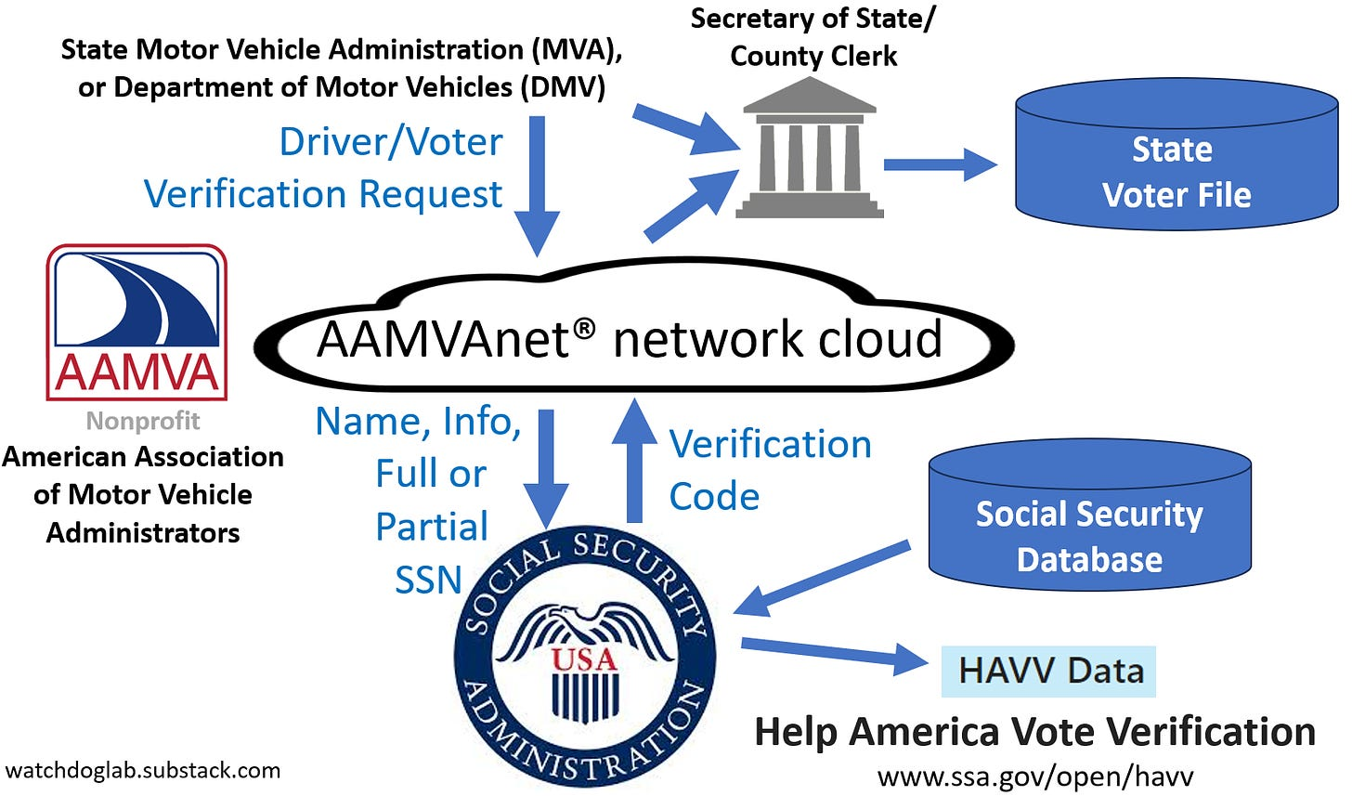
HAVV Background: Conceptual Process
Questions about Help America Vote Verification data in many states https://watchdoglab.substack.com/p/questions-about-help-america-vote
Notes:
Kansas Agreements:
KS Dept of Revenue and Secretary of State [2004, 2006, 2012]
2004: ALL drivers liense records will be verified with the Social Security Administration
2012: 5-digit zip is not considered “personal information”
Both agencies have “contact” person
“Limit access only to those indivdiuals directly responsible”
Silent about reports except for quarterly reports for non-driver IDs
“Nothing in this MOU shall prohibit the SOS from disclosing aggregate information derived from such records as long as protected, personal information is not disclosed.”
KS Dept of Revenue and Social Security Administration [2004]
The DEPARTMENT will verify all drivers license records with the Social Security Administration
The American Association of Motor Vehicle Administrators' (AAMVA) subsidiary AAMVAnet, Inc. is hereafter deemed the "agent" for the Kansas Department of Revenue for billing purposes and will serve as the conduit to transmit information to and receive information from SSA, consistent with the terms of this Agreement. AAMVAnet, Inc. will transmit information to and receive information from SSA on behalf of the Kansas Department of Revenue.
SSA agrees to compare the information fiunished by the Kansas Department of Revenue withinformation in SSA's Master Files of Social Security Number (SSN) Holders and SSN Applications system of records. SSA will respond to the Kansas Department of Revenue through AAMVAnet, Inc. with one of the following responses:
UNI Value = 1 Both name and date of birth (DOB) match
UNI Value = 2 Invalid SSN
UNI Value =3 Name does not match, DOB matches
UNI Value =4 DOB does not match, name matches
UM Value =5 Both name and DOB do not match
UNI Value = 6 We are unable to process the information for the SSN provided. Please
review your information or have your customer visit a Social Security
Administration office.
UNI Value = 9 System error, unable to process at this time.
Progressive connection: Pierre Omidyar’s Democracy Fund publication: Motor Vehicle Departments: Bedrock of American Democracy https://democracyfund.org/idea/motor-vehicle-departments-bedrock-of-american-democracy/ 2021_DF_MotorVehicleDepartmentReport.pdf
Information Exchange Agreement between [state] and the Social Security Administration 2021-2026
https://www.ssa.gov/dataexchange/documents/SSOLV%20model.pdf SSOLV model.pdf
AAMVA Products & Services Catalog
https://www.aamva.org/getmedia/dfdebfd6-1877-4fba-808c-084013e1ec0a/Products-Services-Catalog-Government-Rate-October-2021.pdf NetworkServices-GovtRateSchedule.pdf

Slide 4
Research Questions
Are high HAVV nonmatching rates or high matching deceased rates part of election shenanigans?
Are such high rates indictive of attempts to register non-citizens to vote?
What explains wide HAVV differences among all the states?
When data suggest unusally high HAVV nonmatch rates or high matching deceased rates in a state at a particular time, how can anyone explore the cause at a specific site?
Why is there no feedback loop to address problems?

Slide 5
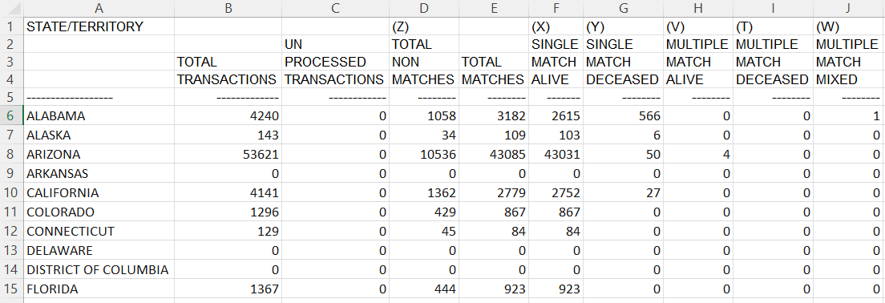

Sample HAVV weekly sheet One of 721 sheets
Data fields used in analysis
. . .
Notes:
C:\efgArchive\2020s\2024\R\HAVV\2024-07-13\HAVV-Recent-Sheet-2024-07-13.xlsx

Slide 6
Focus
Total Transactions
Percent Non Matching Transactions Percent NonMatch = 100 * Z_Total_Nonmatches / Total_Transactions
Percent Matching Deceased Transactions Percent Match Deceased = 100 * (Y_Single_Match_Deceased + T_Multiple_Match_Deceased) / Total_Matches
Percentages provide common comparison metric across all states
Percentages can have a “small n” problem with low denominators
10-Year Time Series (500+ points) Study variation over time
PowerPoint “Analysis of HAVV Data: Technical Details” shows how time series were extracted from online Social Security data

Slide 7
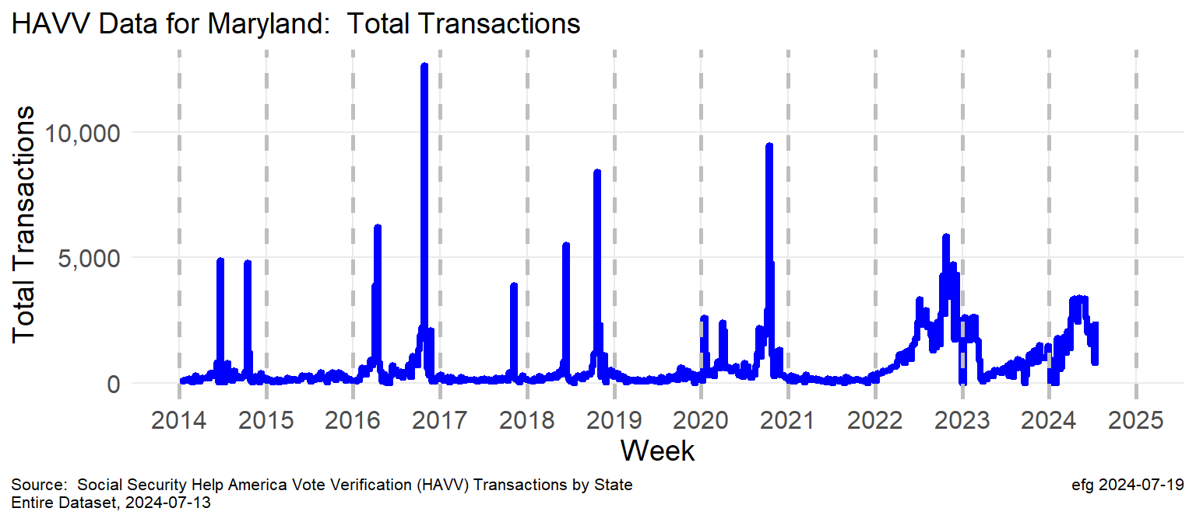
Example: Total Transactions in Maryland
2014, 2016, 2018: spikes before primary and general elections
2020: Two spikes earlier in year; spike before Nov. election
2022-2024: New normal? Year-round electioneering?
Notes:
C:\efgArchive\2020s\2024\R\HAVV\2024-07-13\States-Plots\
Maryland-TotalTransactions.png

Slide 8
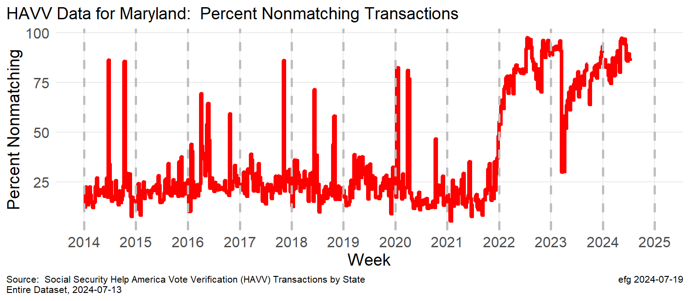
Example: Percent Non Matching Transactions
2014-2020: ~25% non-match rate is typical nonmatch 75+% spikes correlate to many of the total transaction spikes
2022-2024: New normal? 75+% nonmatch rate most of the year
Notes:
C:\efgArchive\2020s\2024\R\HAVV\2024-07-13\States-Plots\ Maryland-PercentNonMatch.png

Slide 9
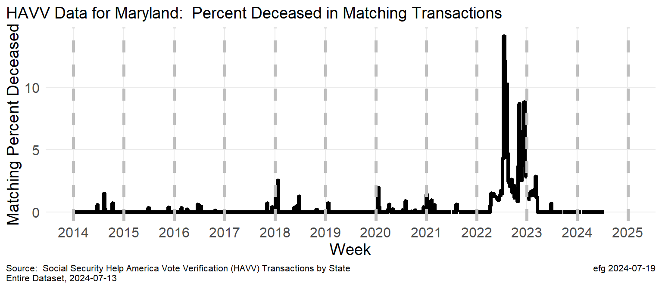
Example: Percent Matching Deceased Transactions
2014-2022: Relatively minor spikes in higher death match rates at times of transaction spikes
2022-2023: Why did death match rates swell in 2022?
Notes:
C:\efgArchive\2020s\2024\R\HAVV\2024-07-13\States-Plots\ Maryland-PercentMatchDeceased.png

Slide 10
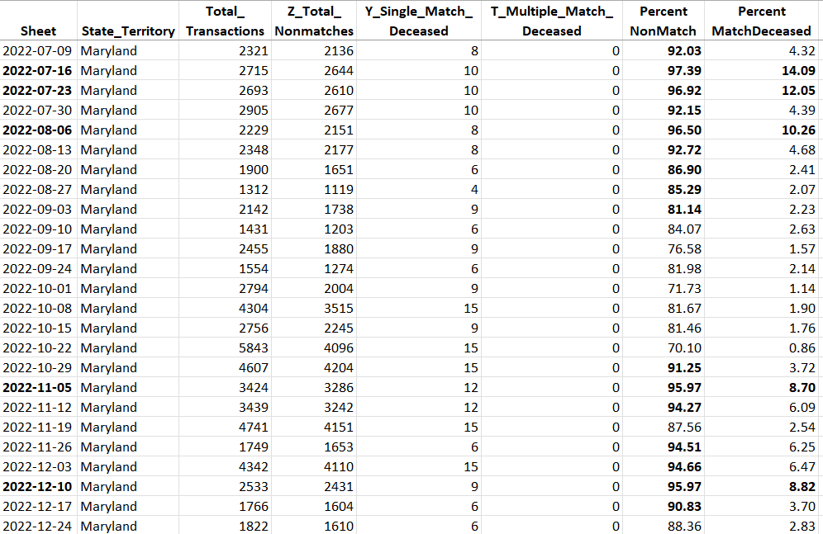
Example: HAVV data corresponding to charts
Maryland-HAVV-through-2024-07-13.xlsx
Sheet column can be used to verify data against www.ssa.gov/open/havv/
Many Excel columns are hidden here. All HAVV data are in the file.
Sheet name identifies the week ending date for when the problem happened.
But where in the state did the problem occur?
Notes:
Can quickly verify data provenance back to SSA web page: https://www.ssa.gov/open/havv/
C:\efgArchive\2020s\2024\R\HAVV\2024-07-13\States-Data\ Maryland-HAVV-through-2024-07-13.xlsx

Slide 11
Near 100% Nonmatch Rate (Sometimes)
Something is wrong when weekly batches of HAVV transactions are mostly rejected!
Some states occasionally show very high nonmatch rates, sometimes approaching 100% (upper limit of y-axis in plots)
CA, GA, MD, MI, NE, NV, NY, TX [8]

Slide 12
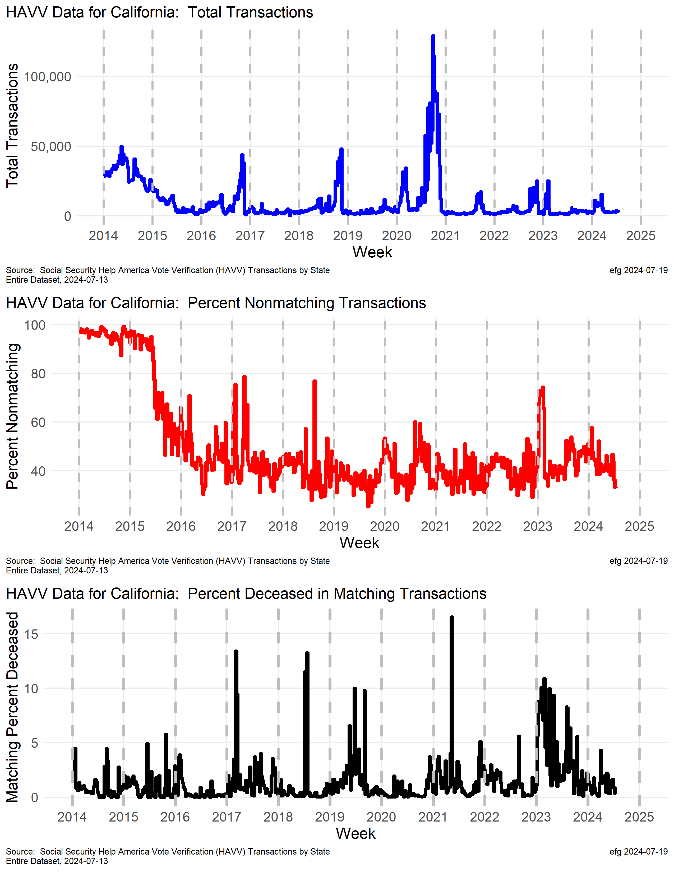
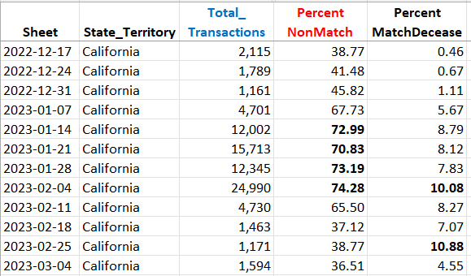
California
Huge transactions spike in late 2020 prior to election.
Near 100% nonmatch rate in 2014 and 40+%. Since then.
Spike in nonmatch rate in early 2023 corresponds to high match deceased rate.
Notes:
Timelines are NOT QUITE aligned between the three charts. [Difficult problem to fix for now.]

Slide 13
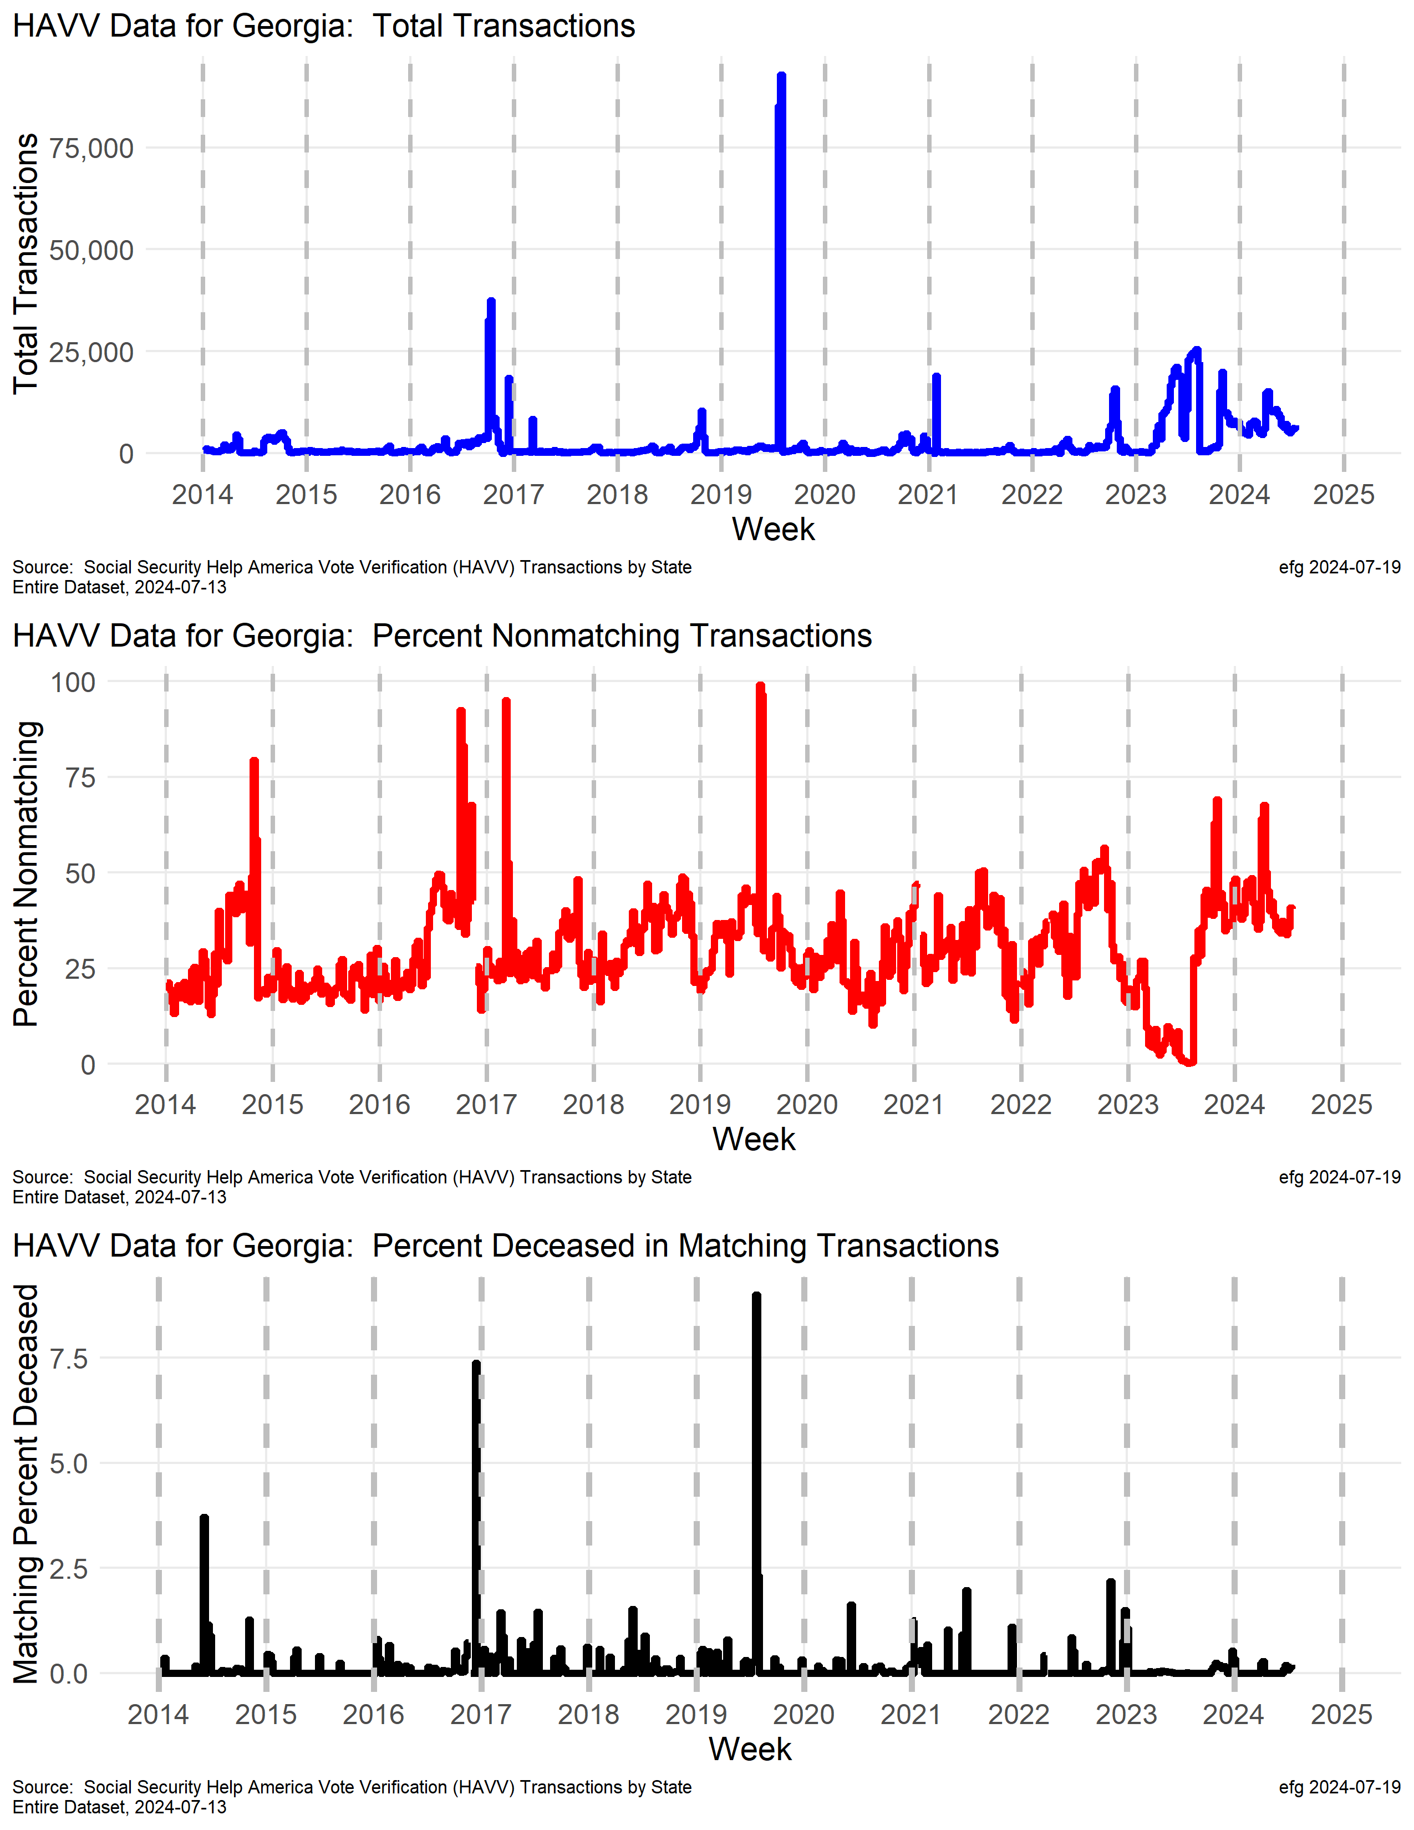
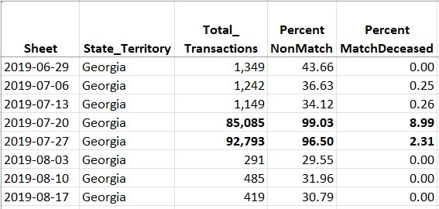
Georgia
?
Huge anomaly in July 2019.
Transactions up in 2023.
Typical recent nonmatching rate is 40+% after low in 2023.
50+% spikes in nonmatch rate in late 2023 and 2024.
Notes:
C:\efgArchive\2020s\2024\R\HAVV\2024-07-13\States-Data\
Georgia-HAVV-through-2024-07-13.xlsx

Slide 14
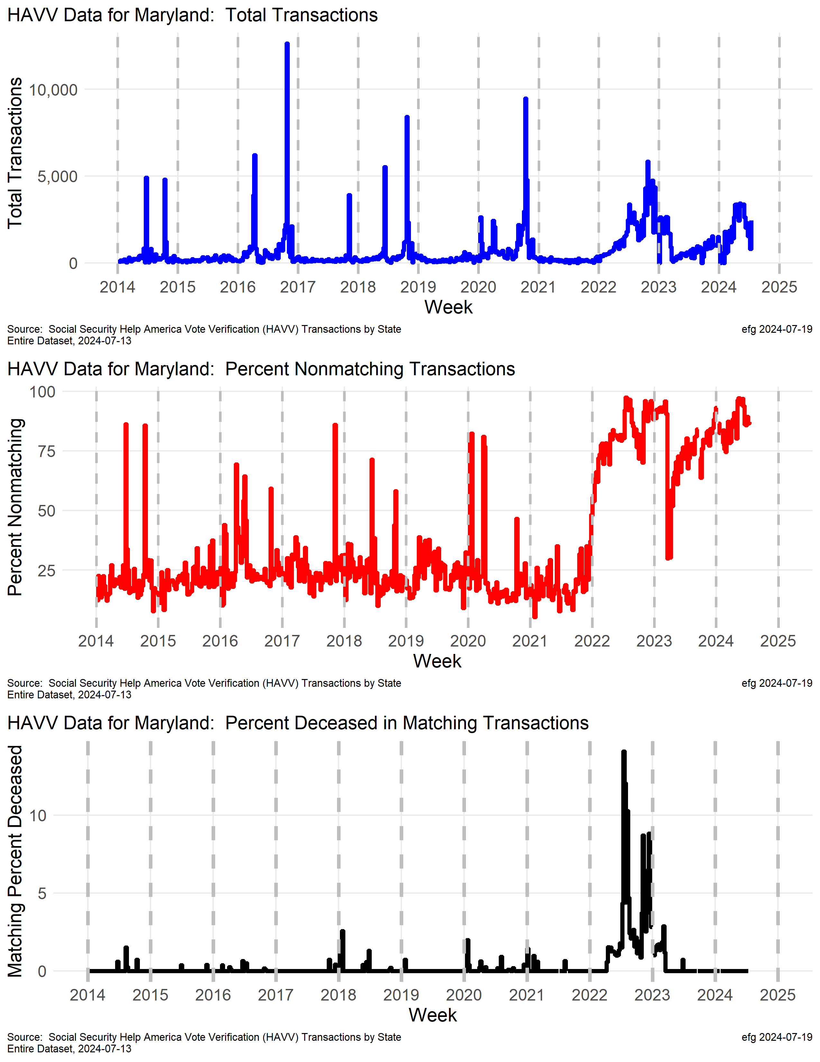
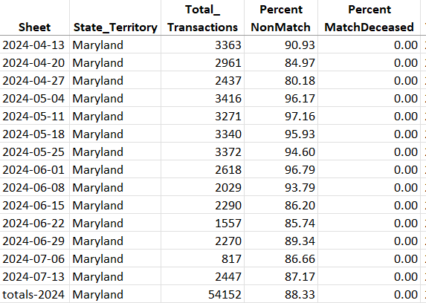
Maryland
What explains the pattern changes in transactions in Maryland starting in early 2022?
Why is the nonmatching rate setting new records in 2022-2024? This rate is often over 75% and sometimes approaches 100%.
Why did the deceased match rates set a new record in mid-2022?
watchdoglab.substack.com/p/questions-about-help-america-vote

Slide 15
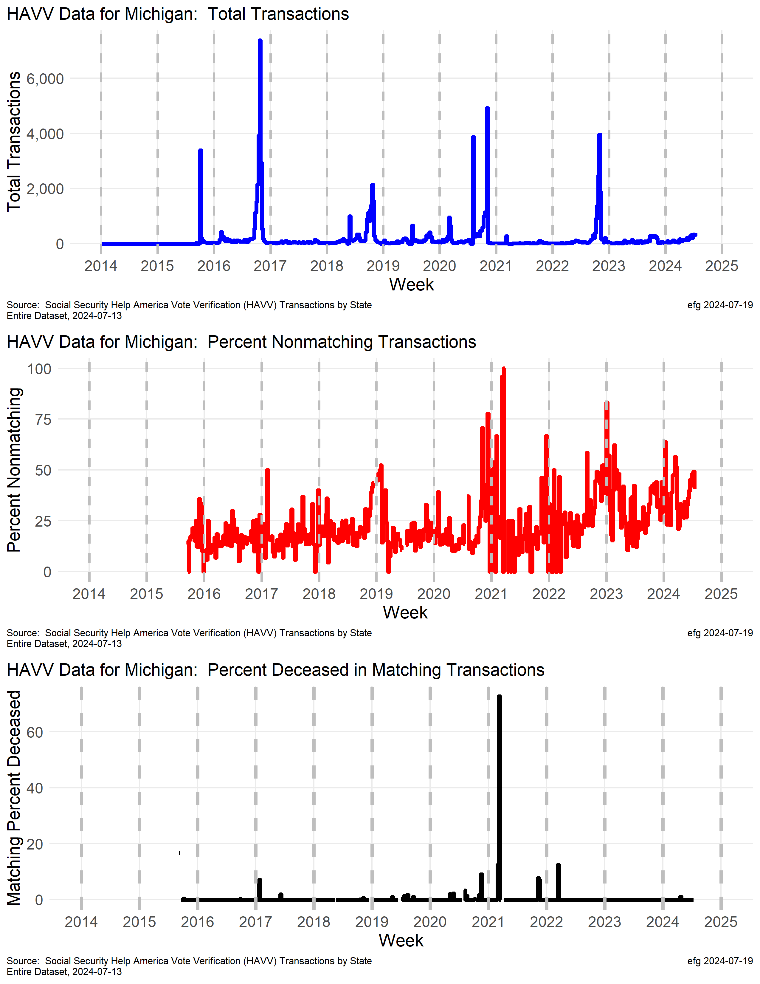
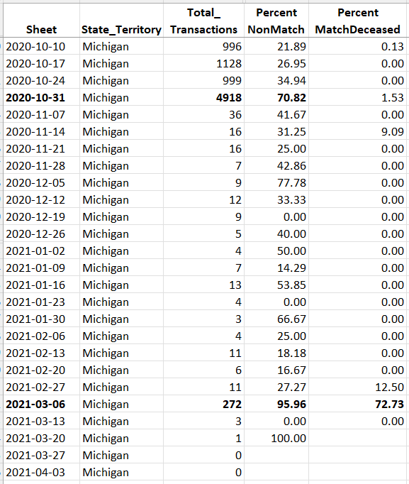
Michigan
June20
Michigan’s nonmatching rate was somewhat stable from 2016-2021, but is now more variable and trending toward 50%.
Small “n”
Notes:
C:\efgArchive\2020s\2024\R\HAVV\2024-07-13\States-Data\
Michigan-HAVV-through-2024-07-13.xlsx

Slide 16
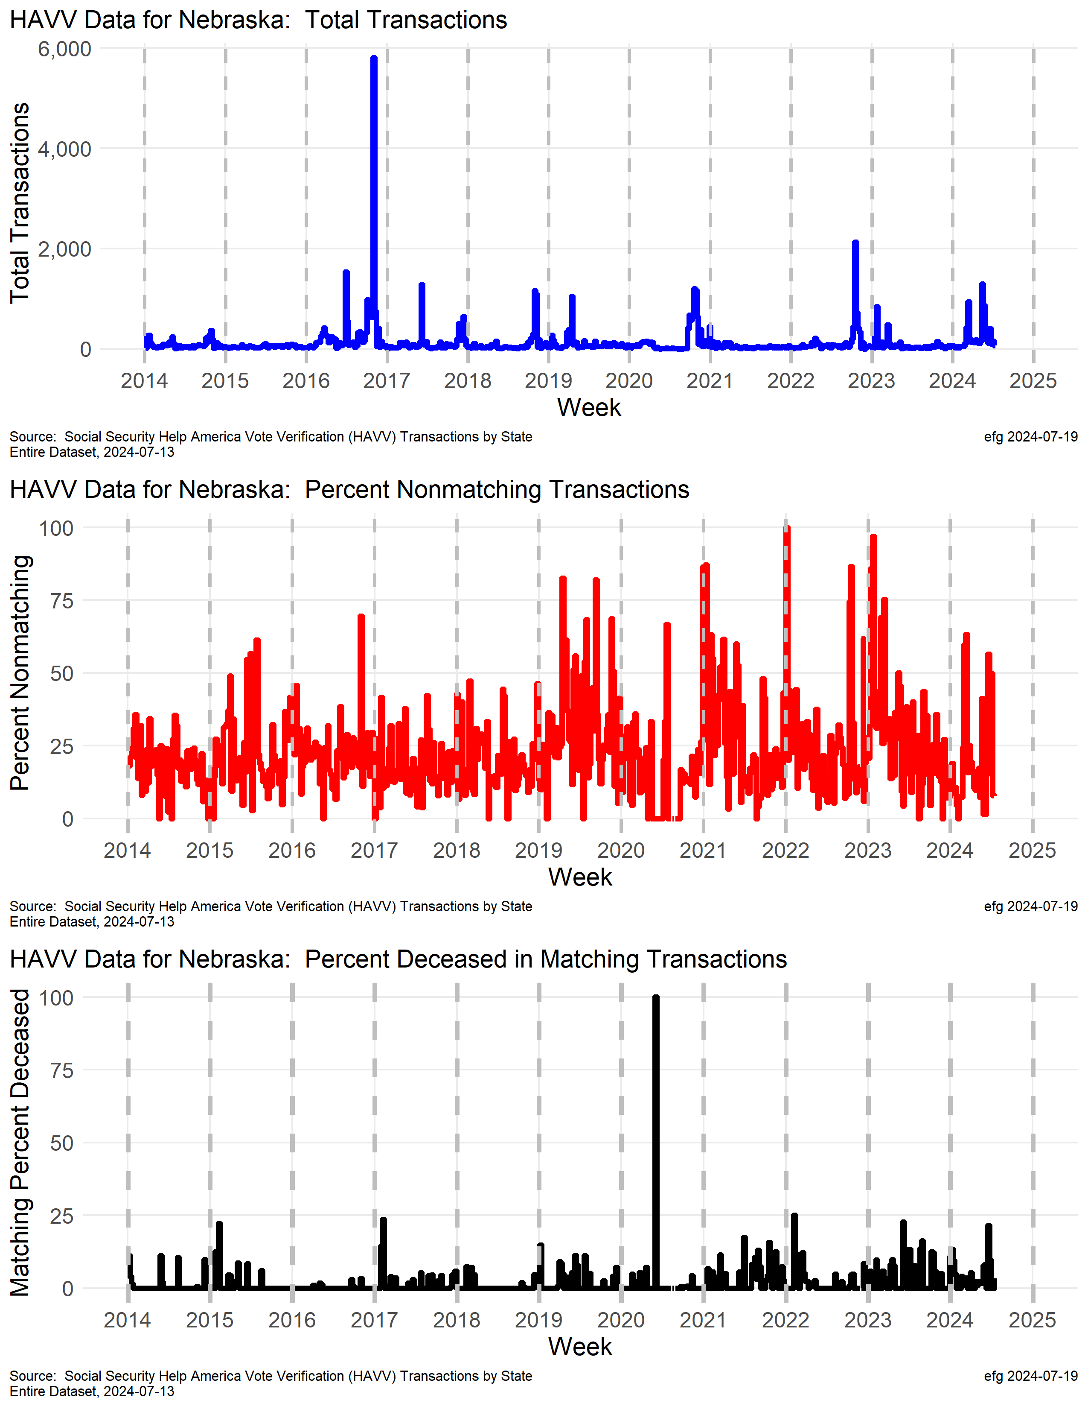
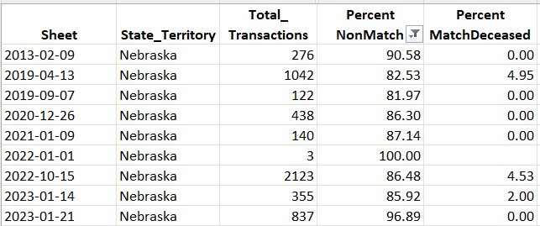
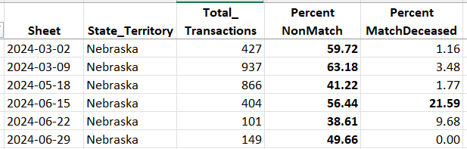
Nebraska
Nonmatching rate has spiked over 50% three times this year.
Percent deceased rate over 21% in week ending June 15, 2024
Small “n” 2 out 2
Notes:
C:\efgArchive\2020s\2024\R\HAVV\2024-07-13\States-Data
weeks in 2024 o nonmatch rats over 40%. Percent deceased match over 21% in week ending 6/15

Slide 17
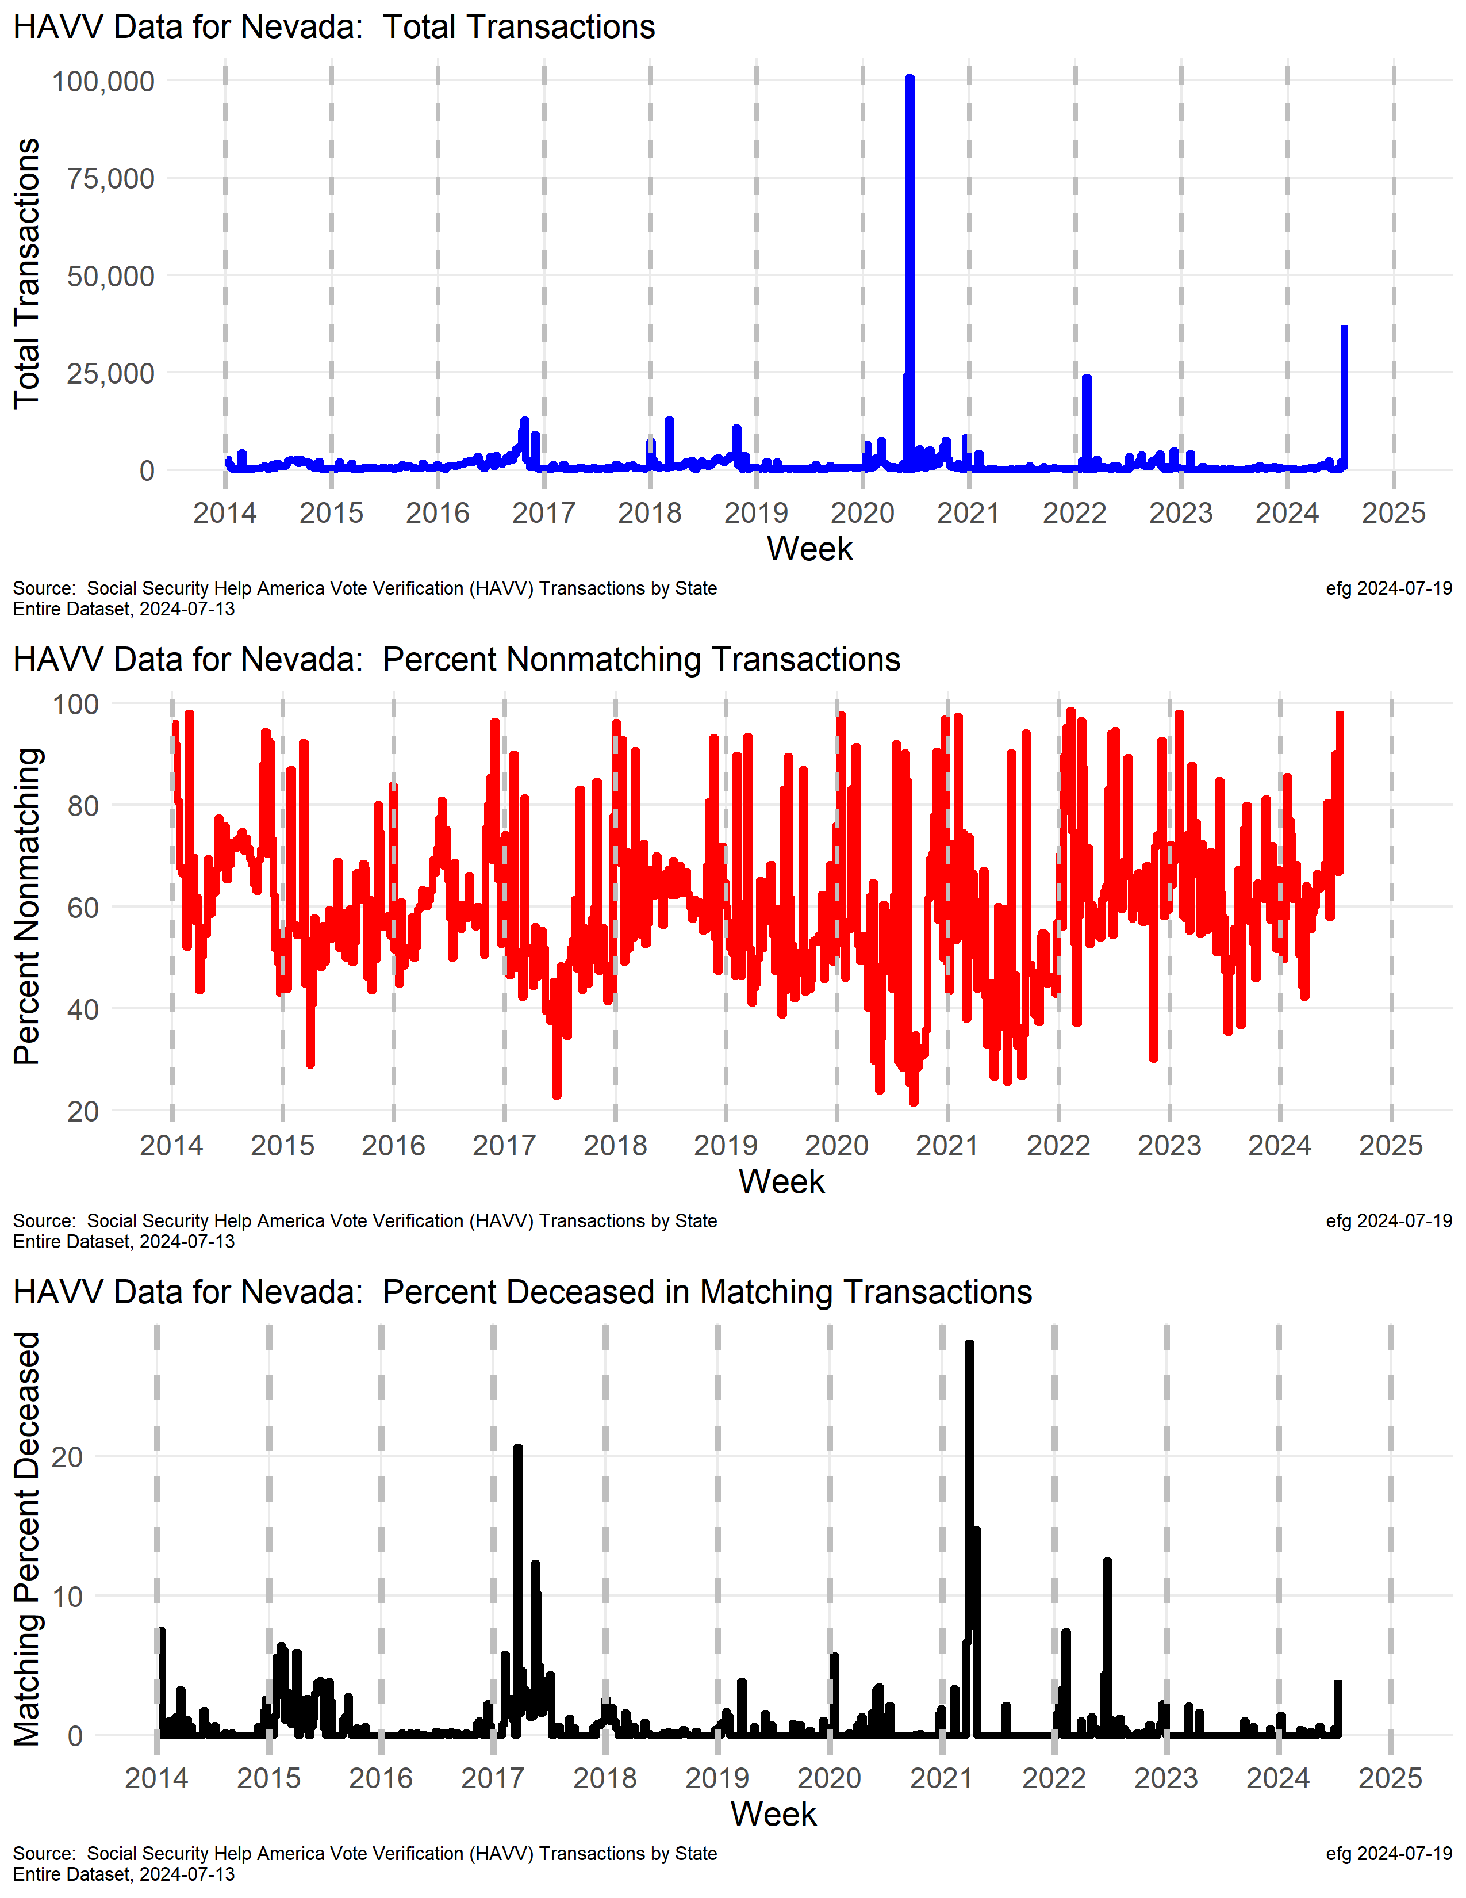
Nevada
Something is wrong in Nevada.
The nonmatching rate has often been consistently above 50% since 2014.
In the week ending July 13, 2024 there were 37,181 transactions and 36,600 nonmatches (98.4%).
In the week ending June 29, 2024 there were 2036 transactions and 1835 nonmatches (90.1%).
Notes:
Chronic issue of over 50% nonmatch rate

Slide 18
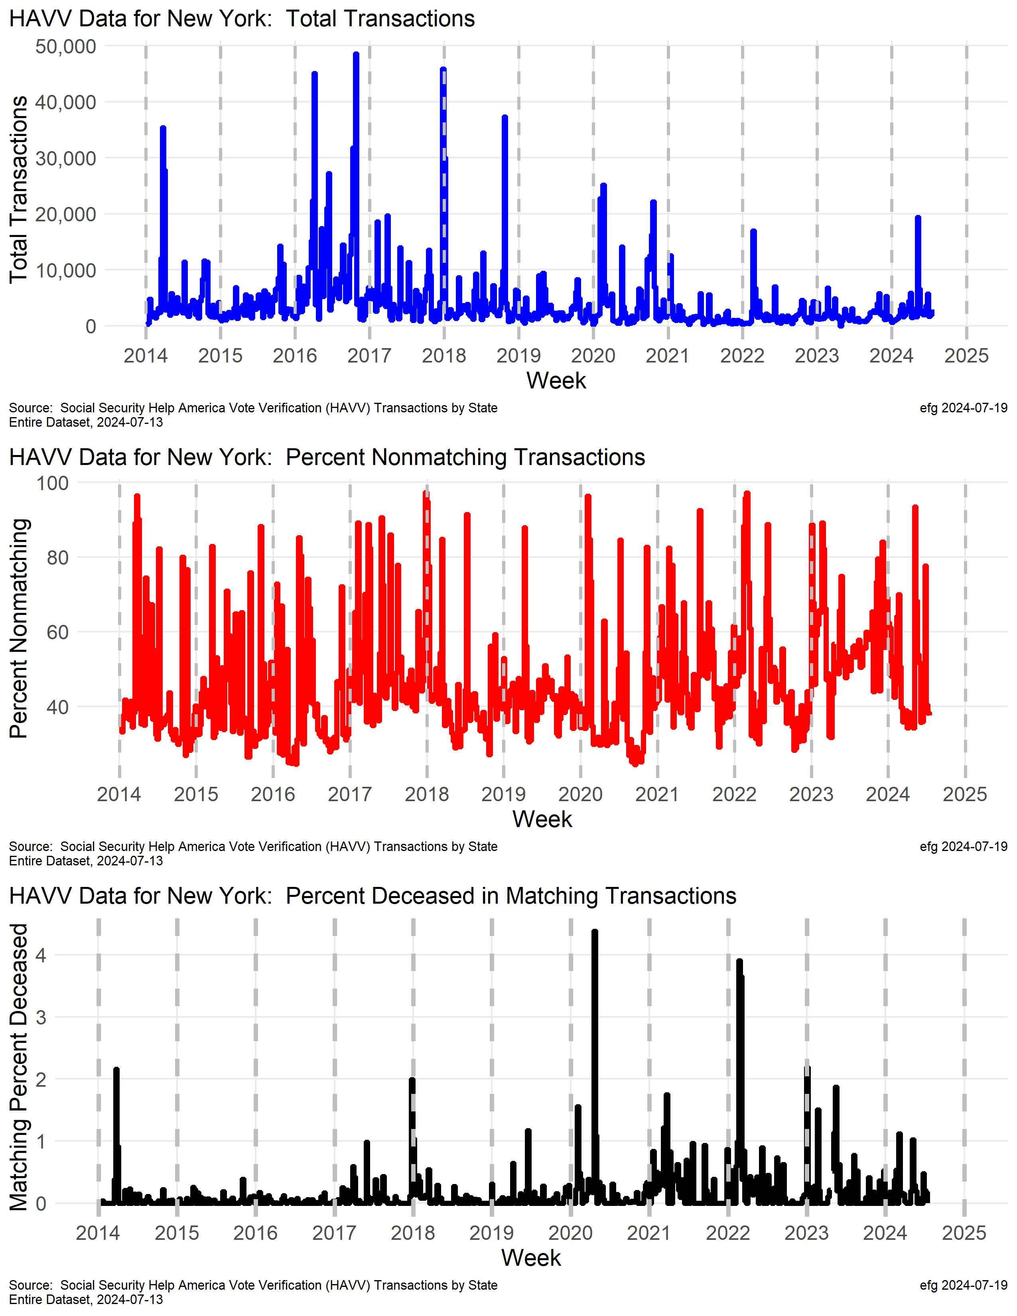
New York
Why does New York's nonmatch rate spike periodically over 90% and is still 40+% most of the time?
New York's match death rate is much lower than many other states.
watchdoglab.substack.com/p/ questions-about-help-america-vote

Slide 19
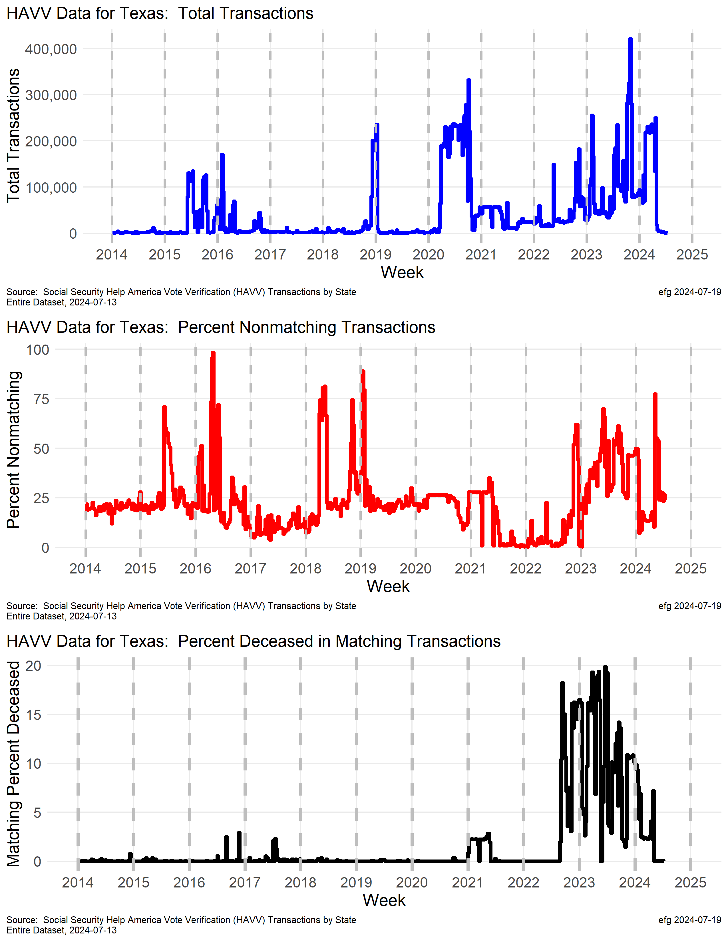
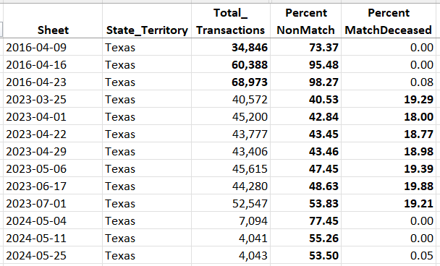
Texas
watchdoglab.substack.com/p/ questions-about-help-america-vote
Whole State?
Largest transaction numbers of any state.
What's causing the upward trend in the nonmatch rate since late 2022? [95% and 98% in April 2016 on 60,000+ transactions!]
Why was the deceased match rate so high and erratic in 2023?

Slide 20
Current HAVV Data Issues
Variety of past and current HAVV issues
Irregular weekly transaction rates
High/irregular nonmatching percentage
High/irregular death match percentage
AL, AK, AZ, AR, CO, IA, IL, KS, MA, MO, MT, NC, OH, OR, PA, RI, SD, UT [18]

Slide 21
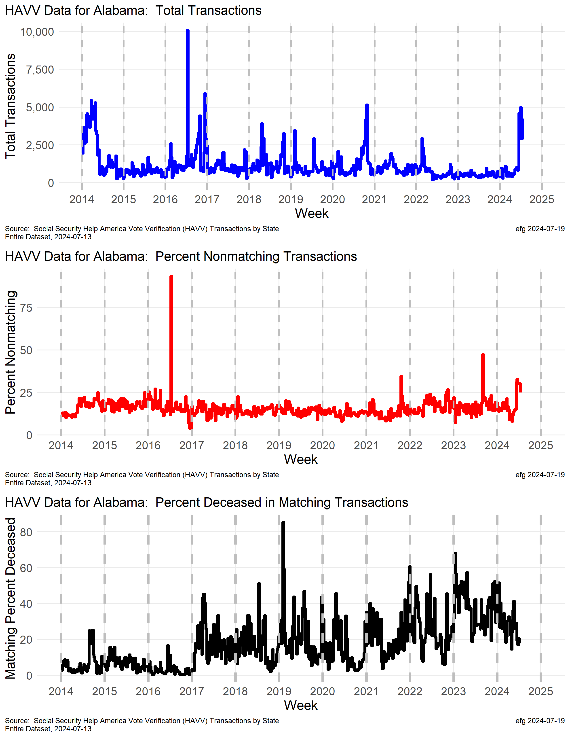
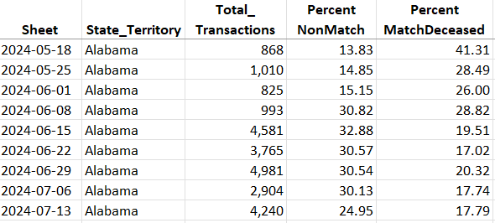
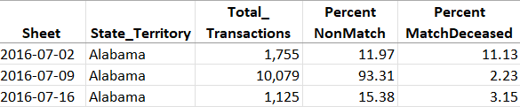
Alabama
Very recent spike in transactions and increased nonmatching transactions.
Why has the deceased match rate been mostly 20+% since 2017?
What happened before the 2016 election?
Notes:
C:\efgArchive\2020s\2024\R\HAVV\2024-07-13\State-Plots\
Alabama-HAVV-Data-2024-07-13.png
C:\efgArchive\2020s\2024\R\HAVV\2024-07-13\States-Data\
Alabama-HAVV-through-2024-07-13.xlsx

Slide 22
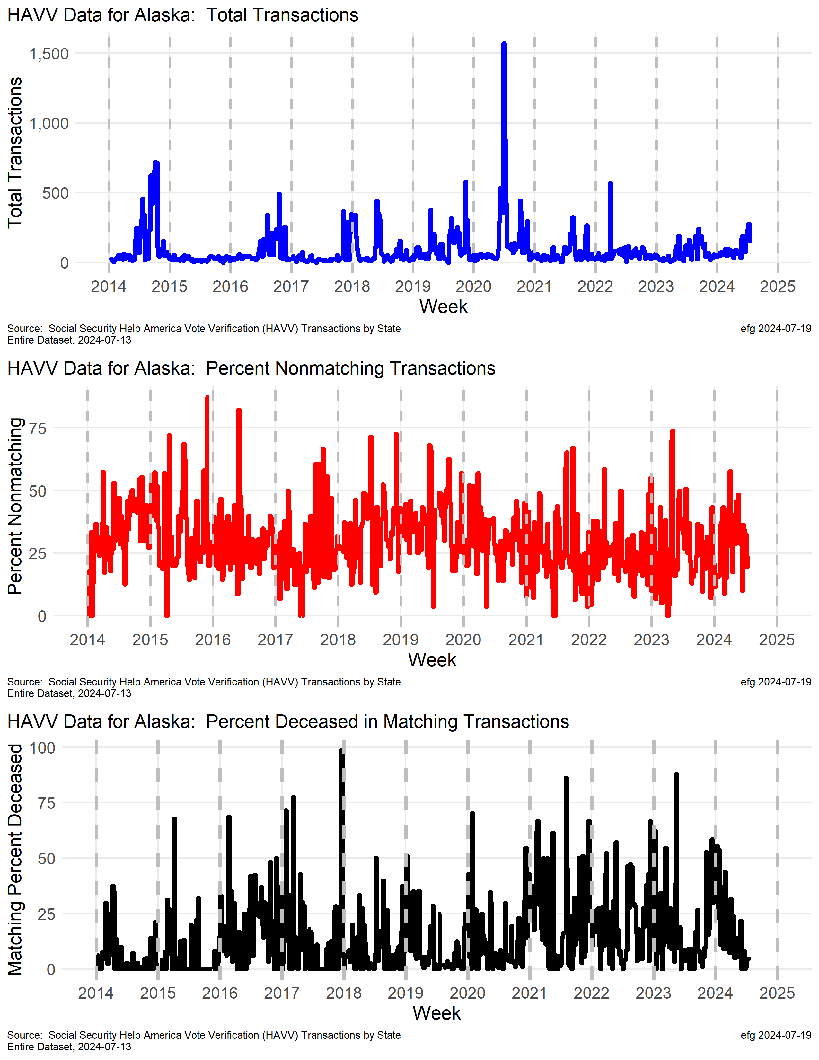
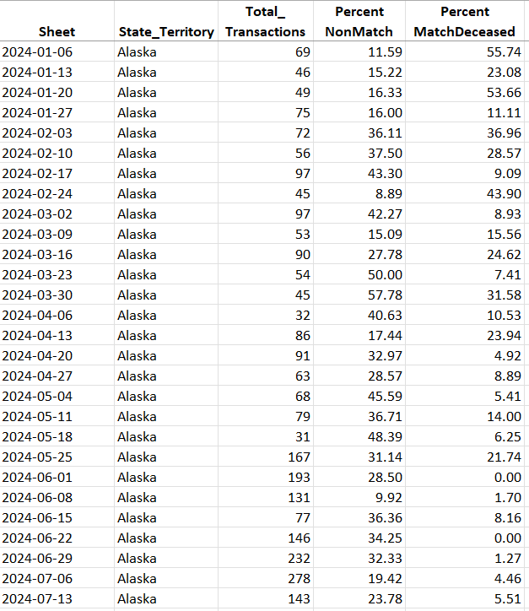
Alaska
2024 shows declining deceased matching rate, but the rate was over 50% earlier this year. What changed?
Small “n”

Slide 23
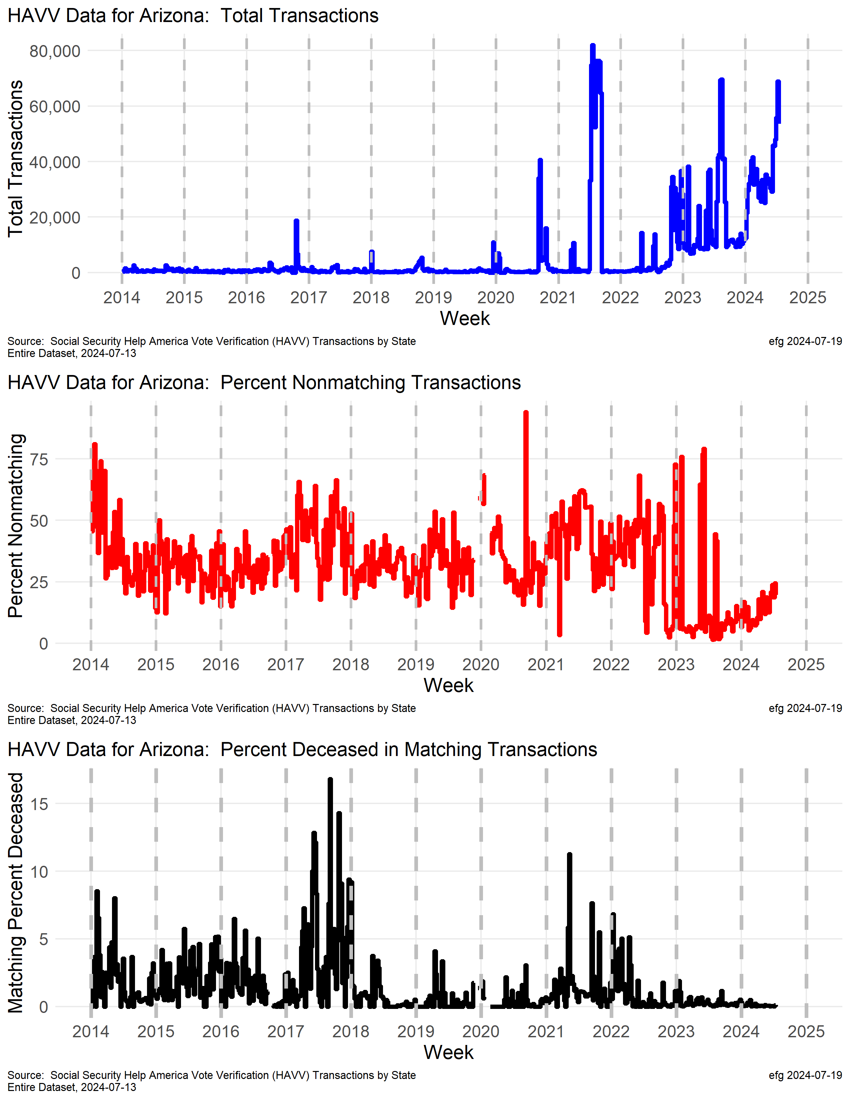
Arizona
Why are total transactions erratic but trending upward in 2023-2024?
Some large swings in nonmatching rates since mid-2022. Sometimes lower in late 2023 than 2022, but steadily increasing now.
Percent Deceased in Matching is at a very low rate since mid-2022.

Slide 24
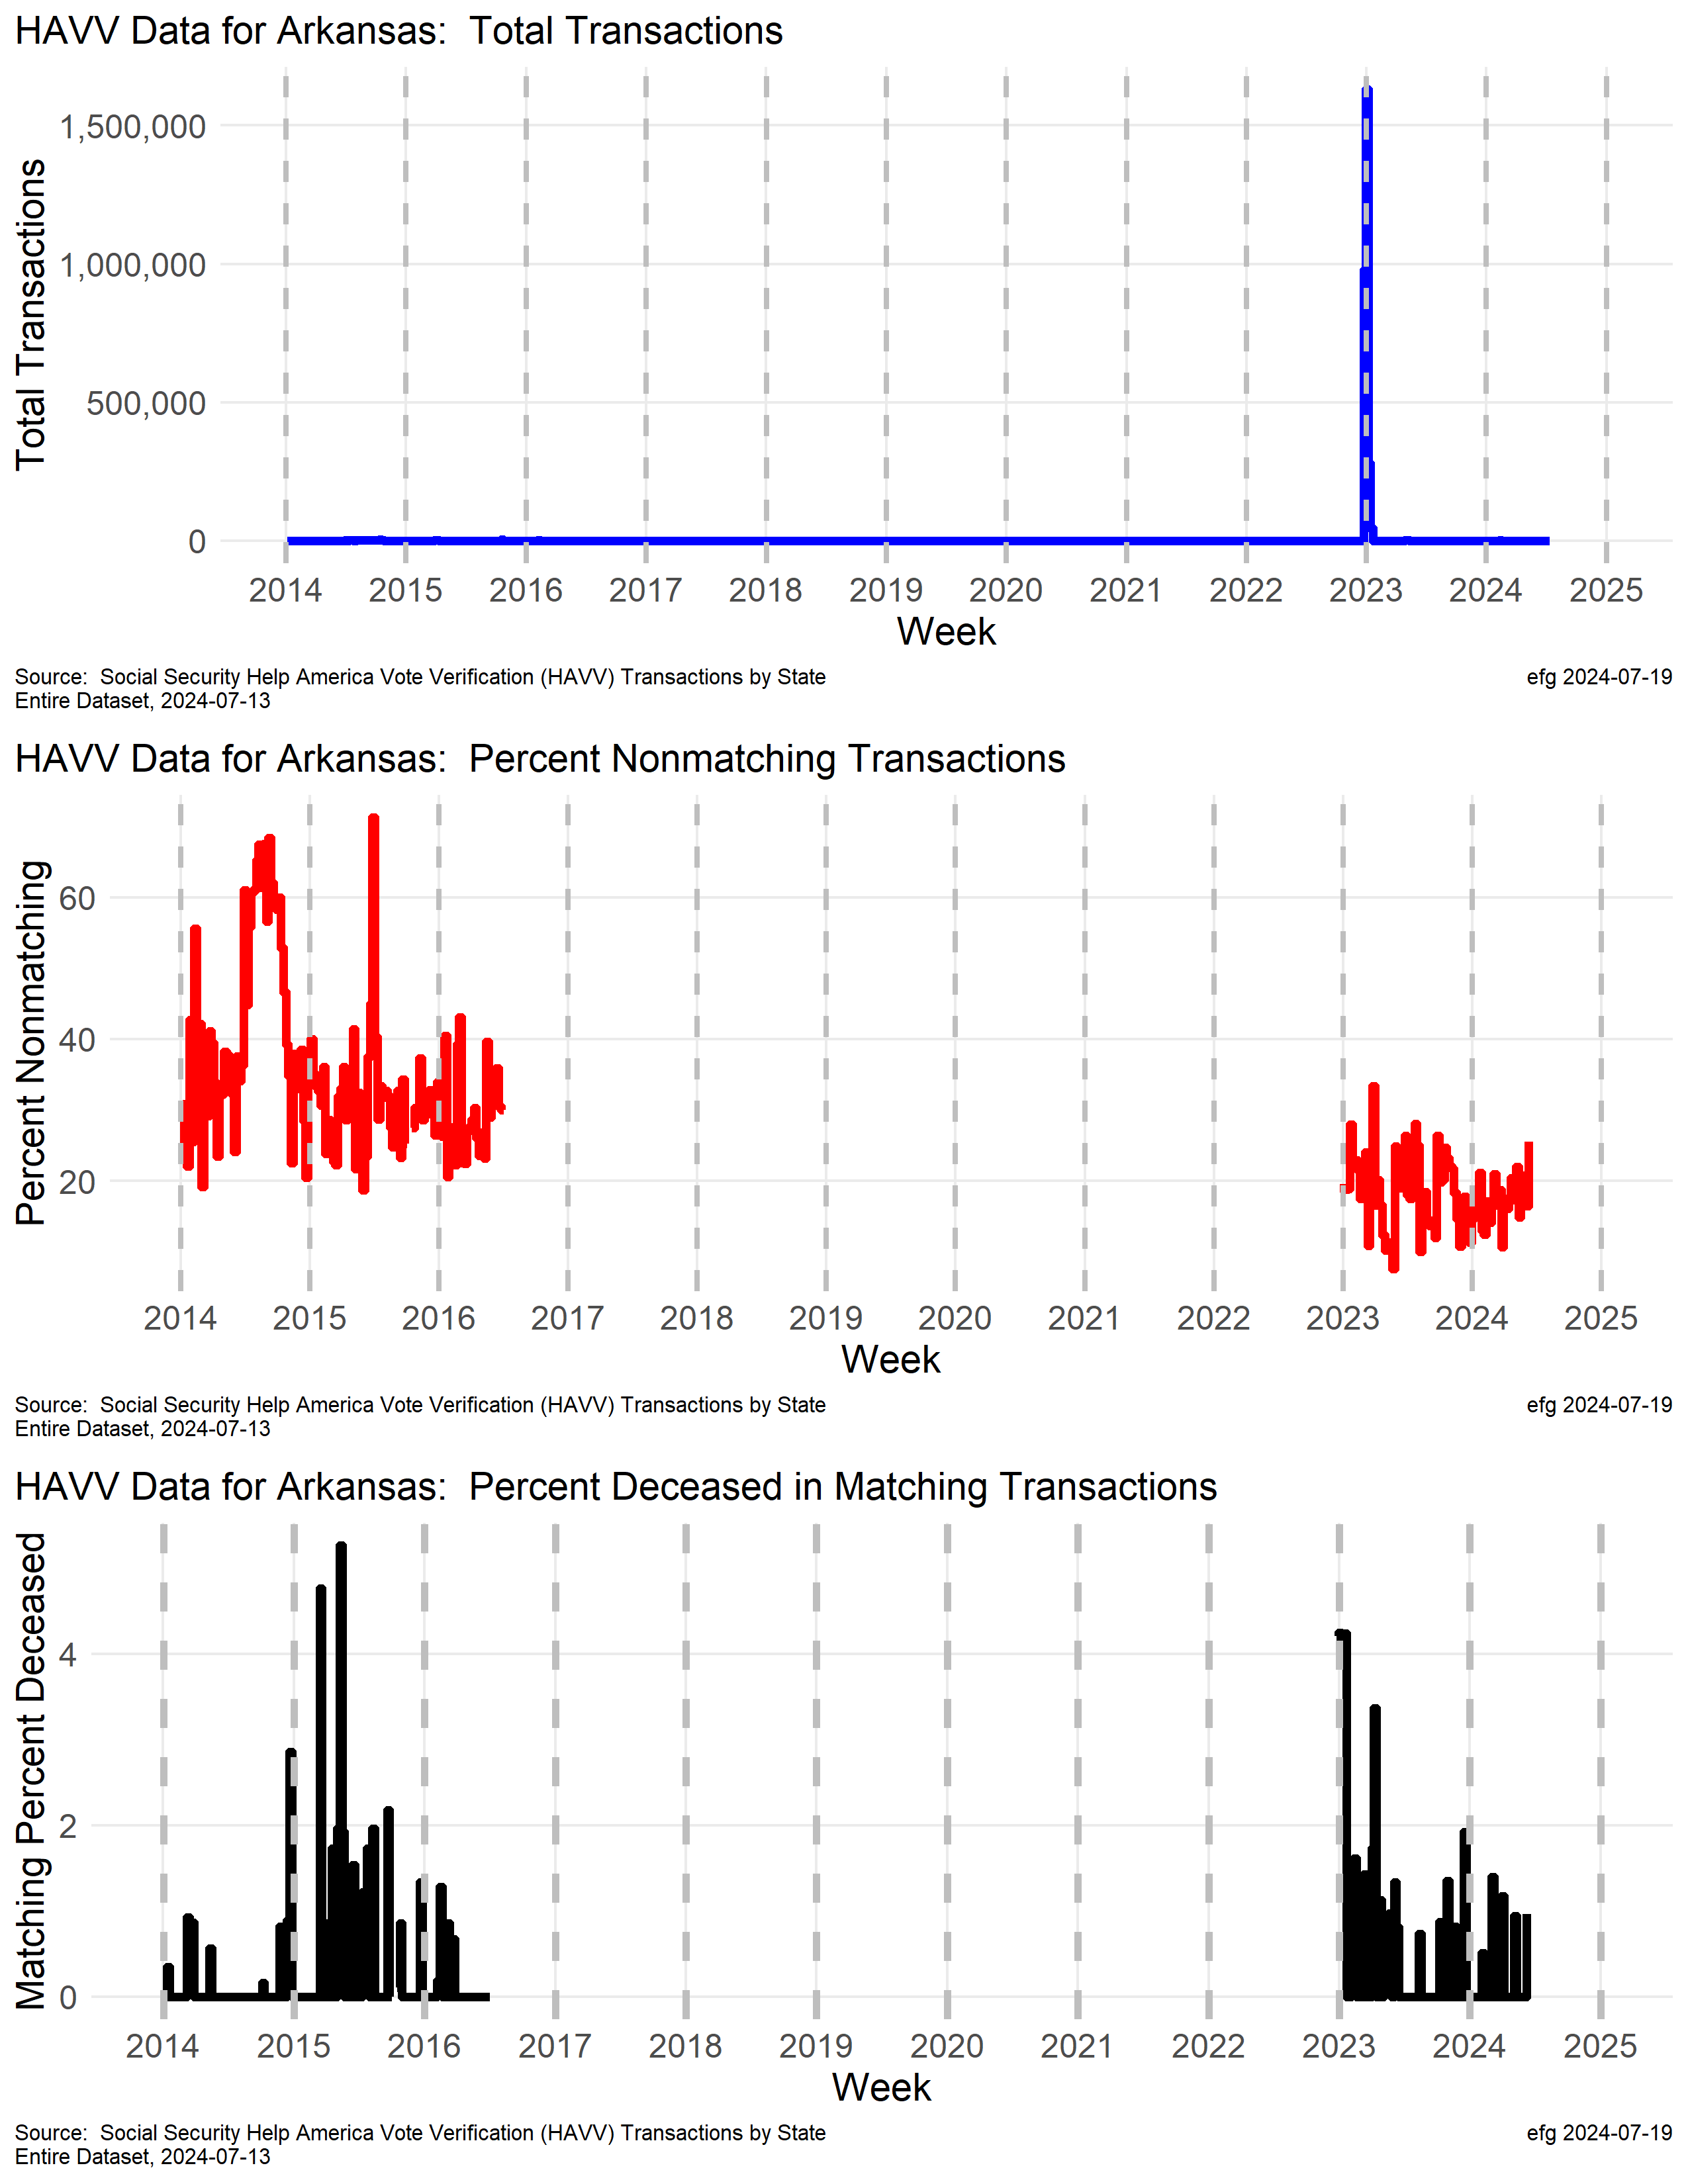
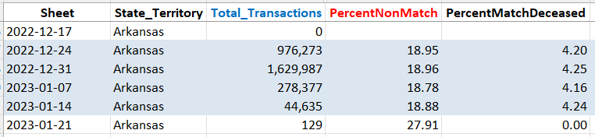
Arkansas
Whole State?
Processed all Arkansas voters in late 2022 and early 2023?

Slide 25
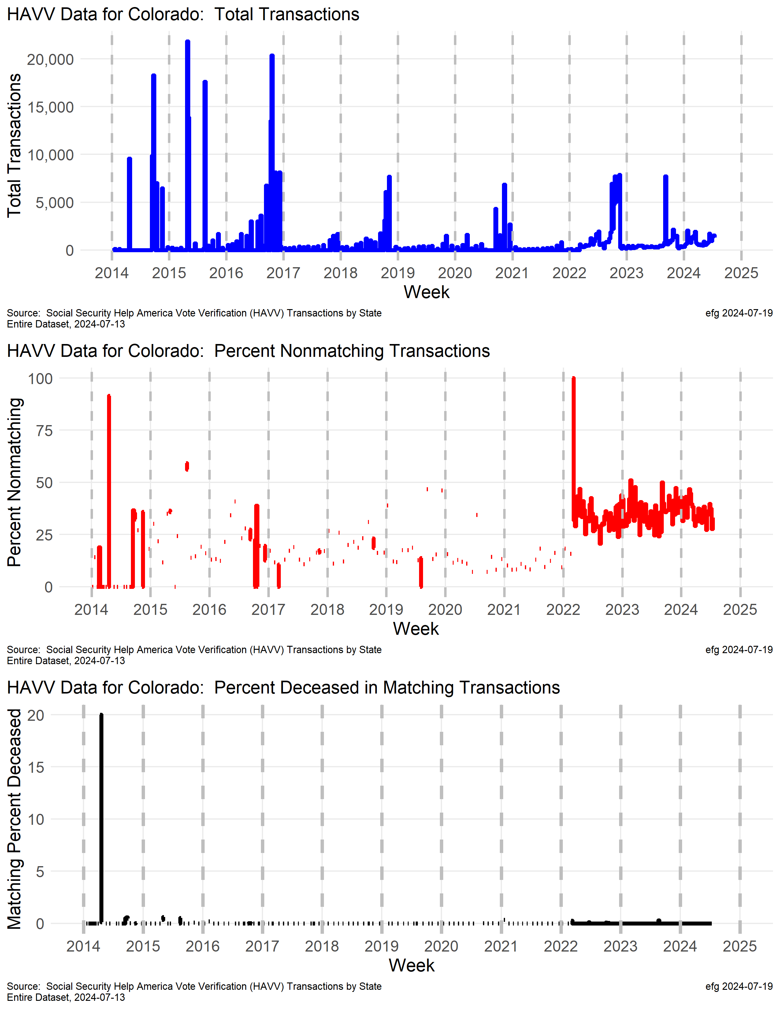
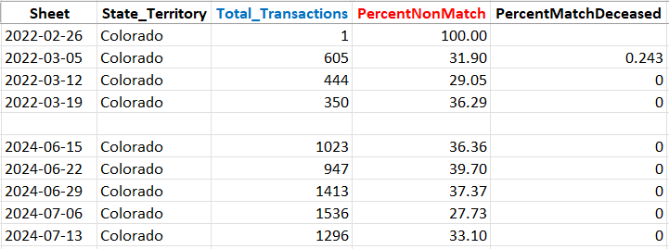
Colorado
30+% nonmatch rate since early 2022 through 2024
100% of 1

Slide 26
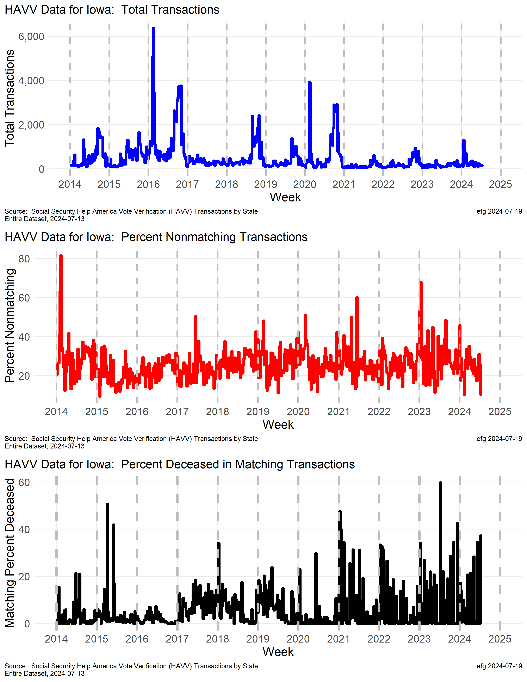
Iowa
Why is the deceased match rate climbing this year? And last year?

Slide 27
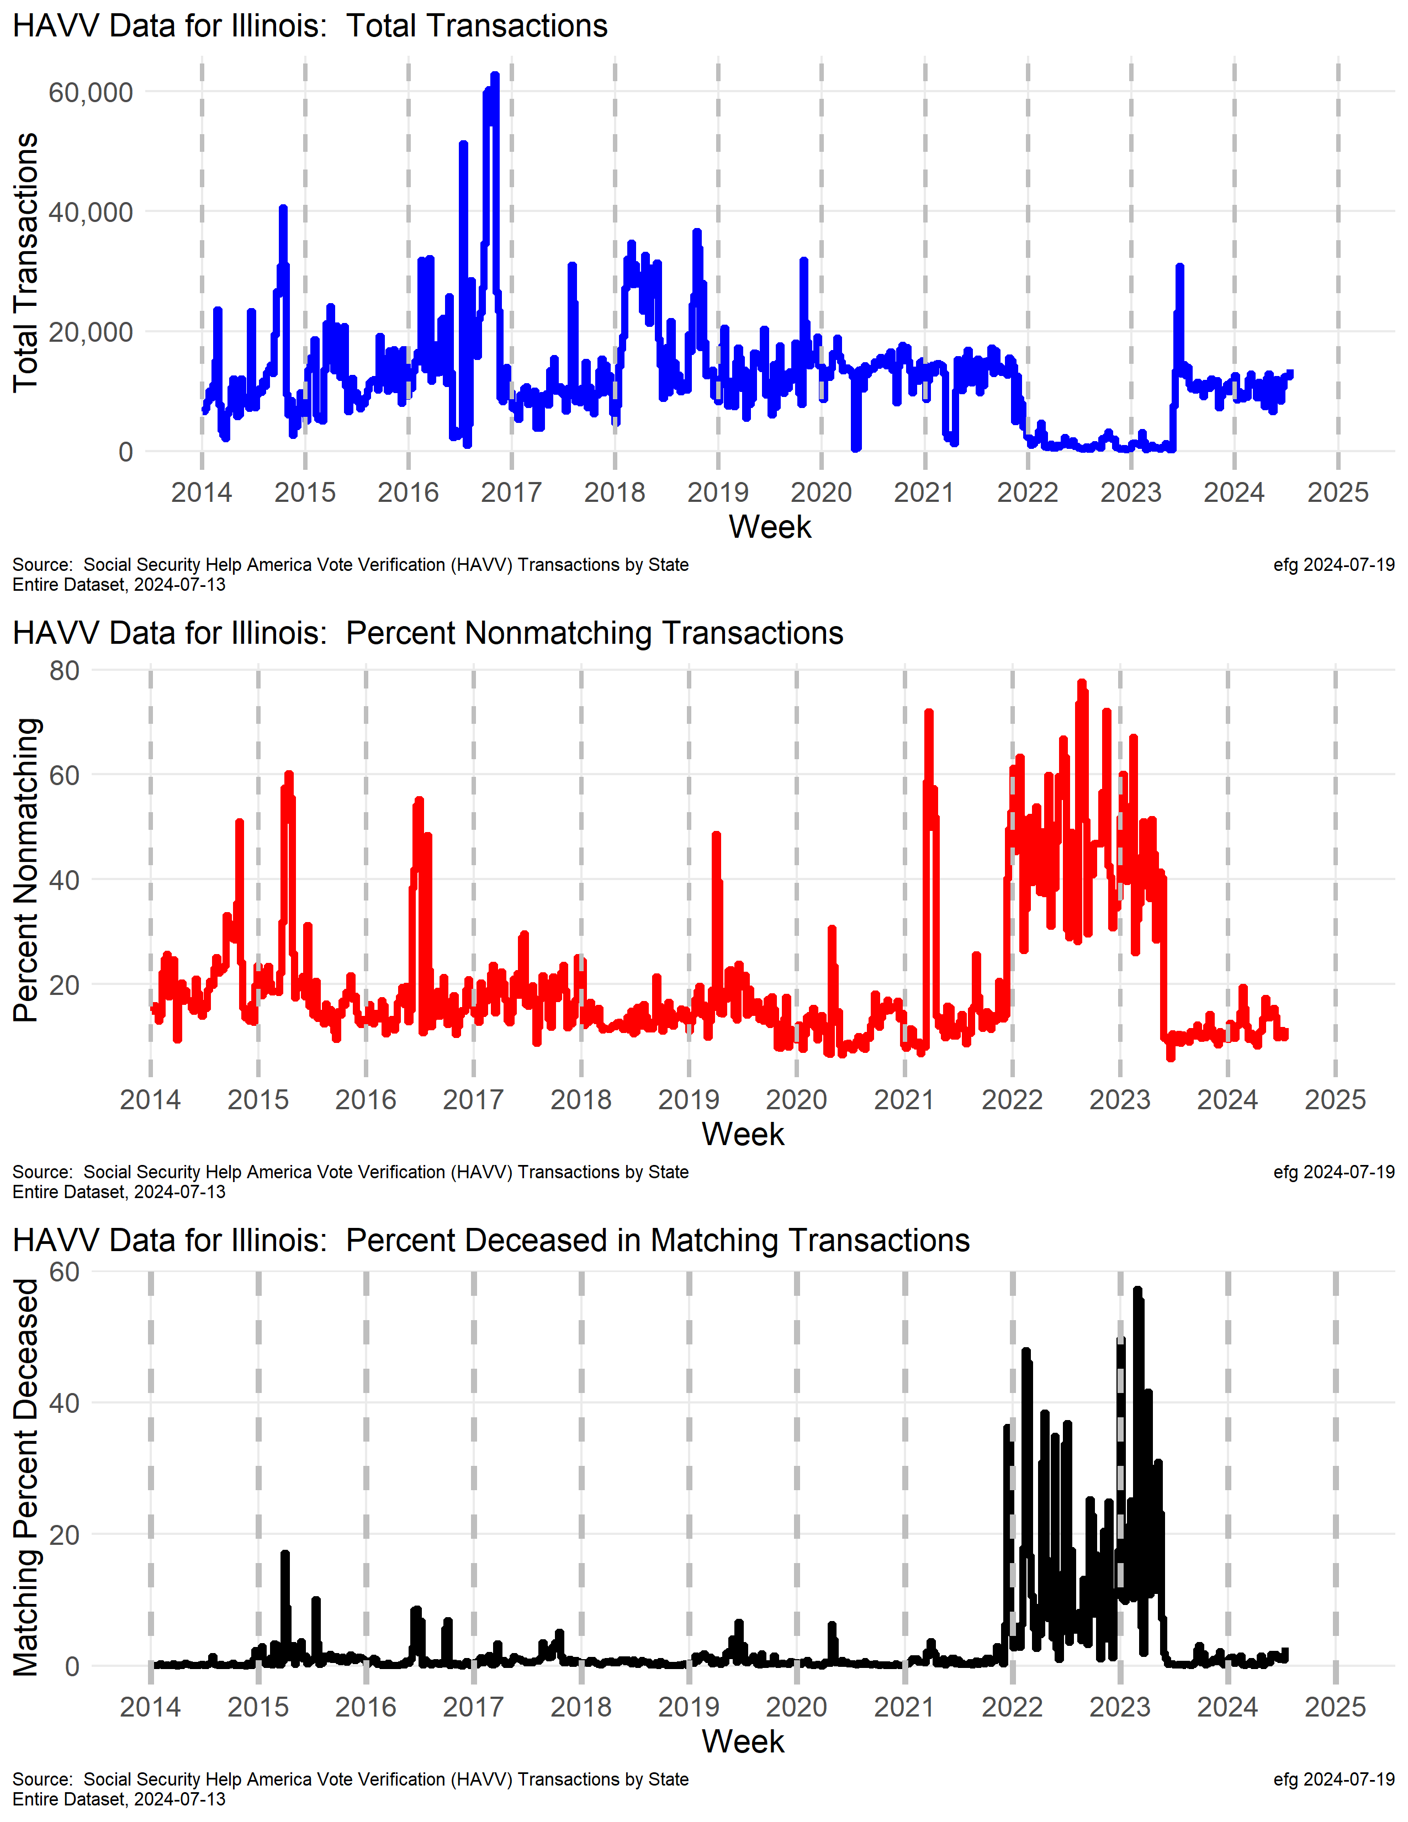
Illinois
For some reason transaction volume in Illinois was down in 2022 and early 2023 to about 1200/week, but nonmatch and match but deceased rates were higher during this same period.
A normal transaction rate was then seen in late 2023 and so far in 2024.
The deceased match rate was quite high in 2022 and early 2023.
watchdoglab.substack.com/p/ questions-about-help-america-vote

Slide 28
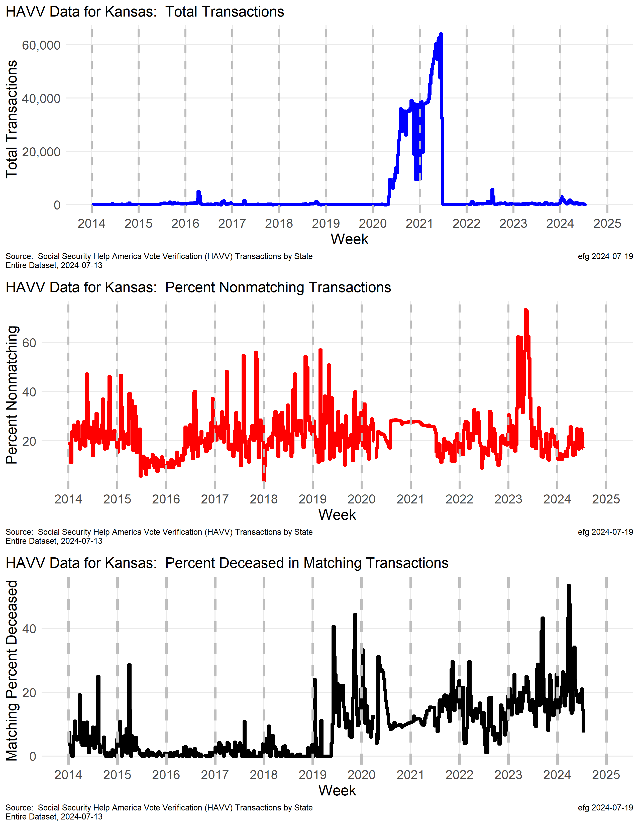
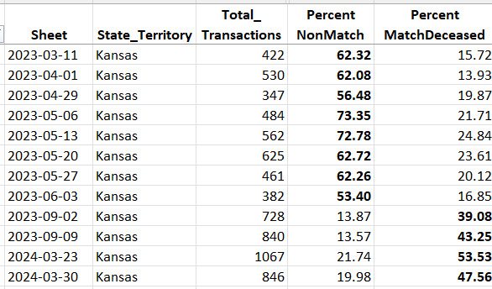
Kansas
Whole State?
Transaction counts suggest whole Kansas voter file processed through HAVV starting in mid-2020? But HAVV supposedly is only for new applications?
Why was nonmatch rate ~30% while processing whole state file?
Increase in death match rate in 2024.
https://watchdoglab.substack.com/p/ understanding-kansas-help-america
Notes:
The blue line shows points for the number of total HAVV transactions for each of the 543 weeks from Jan. 4, 2014 through May 25, 2024.
There are some minor “spikes” in 2016 and 2022, but one large wide spike from mid-2020 through mid-2021 dominates the plot.
A software update might explain this huge number of transactions -- the only two "valleys" in this spike were over Thanksgiving and Christmas weeks.
From mid-2020 through mid-2021 there were over 2 million HAVV transactions. If one subtracts about 20,000 for a “normal” year (like 2014 or 2023), the resulting number is approximately the number Kansans registered at that time.
Was the whole Kansas voter file processed through HAVV starting in mid-2020? But why was that done since HAVV supposedly is only for new applications?
The red line shows the percentage of transactions for each of the 543 weeks that did not match information from Social Security.
This red line shows two curiosities:
While processing the whole Kansas voter file in 2020-2021 new records were set both years: 26.5% of transactions did not match in 2020. 26.7% of transactions did not match in 2021.
What explains the spike in non-matches in 2023 when 30.7% of HAVV transactions matched no Social Security records last year. The weeks of May 6 and May 13, 2023, showed about 73% of transactions did not match. Four other weeks in 2023 had mismatch rates of about 62%.
During the week of March 23, 2024 the HAVV data show Kansas had 1067 total transactions with 835 matches -- so 232 or 21.7% did not match that week (red line in plot above).
But of those 835 matches, the HAVV data show 447 were "Single Match Deceased", which indicates 53.5% of the matches were possibly deceased. Should such a high deceased match percentage trigger some additional investigation?
Curiosities:
Why was the percent deceased in matching records 53.5% during one week March?
Why is this rate for 2024 so far setting a new yearly record of over 23% when the overall rate since 2011 is only 11.5%?
Why has the deceased rate among Social Security matches been trending upward since early 2019?

Slide 29
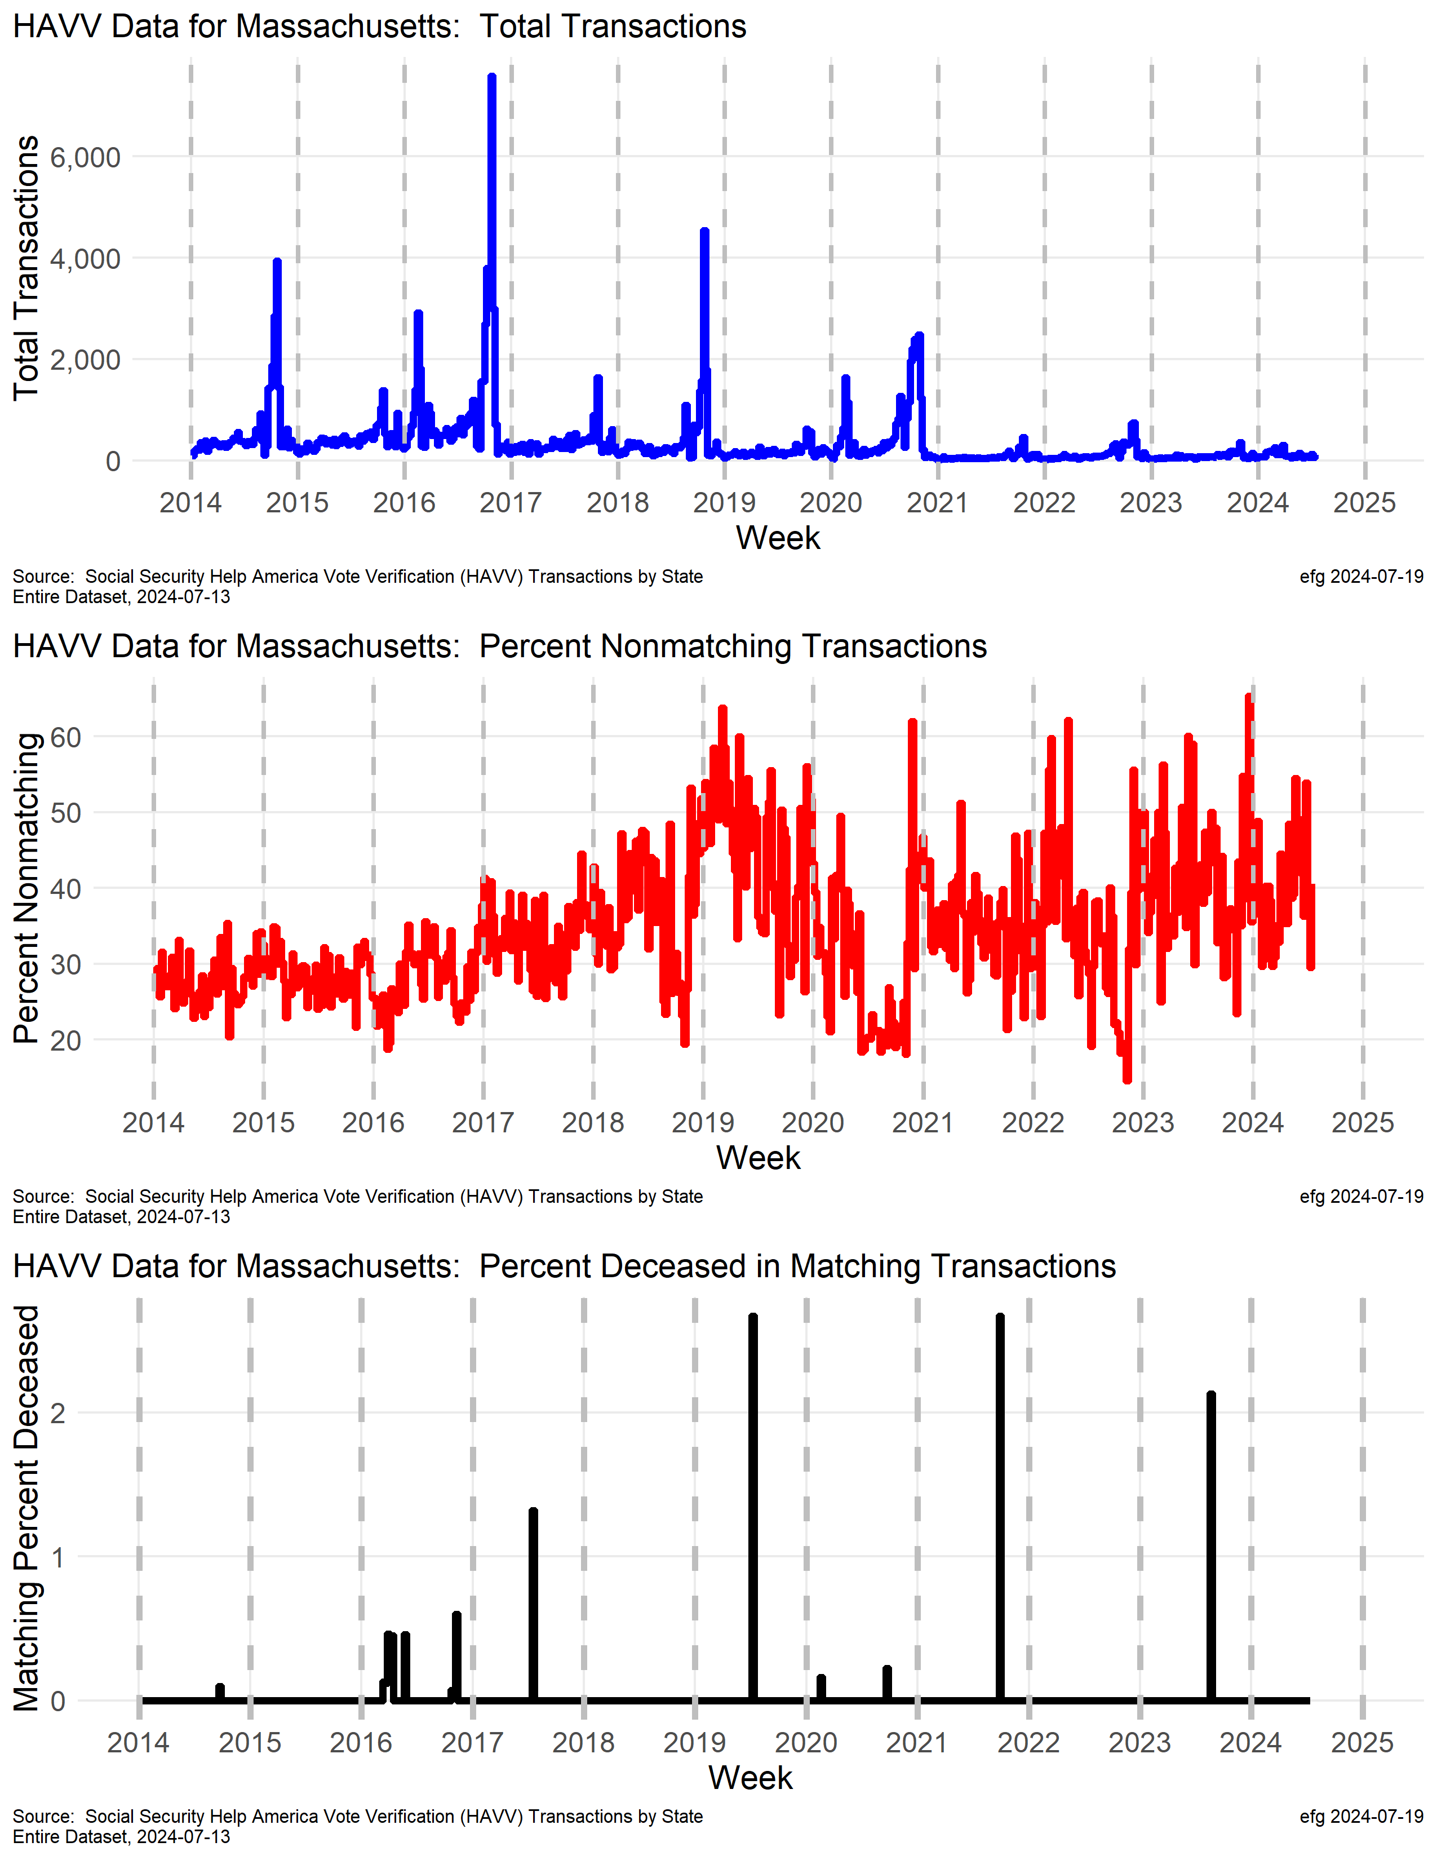
Massachusetts
Weekly transactions in Massachuetts are fairly small.
Massachusetts’ nonmatch rate has been trending upward and is now often over 40%.

Slide 30
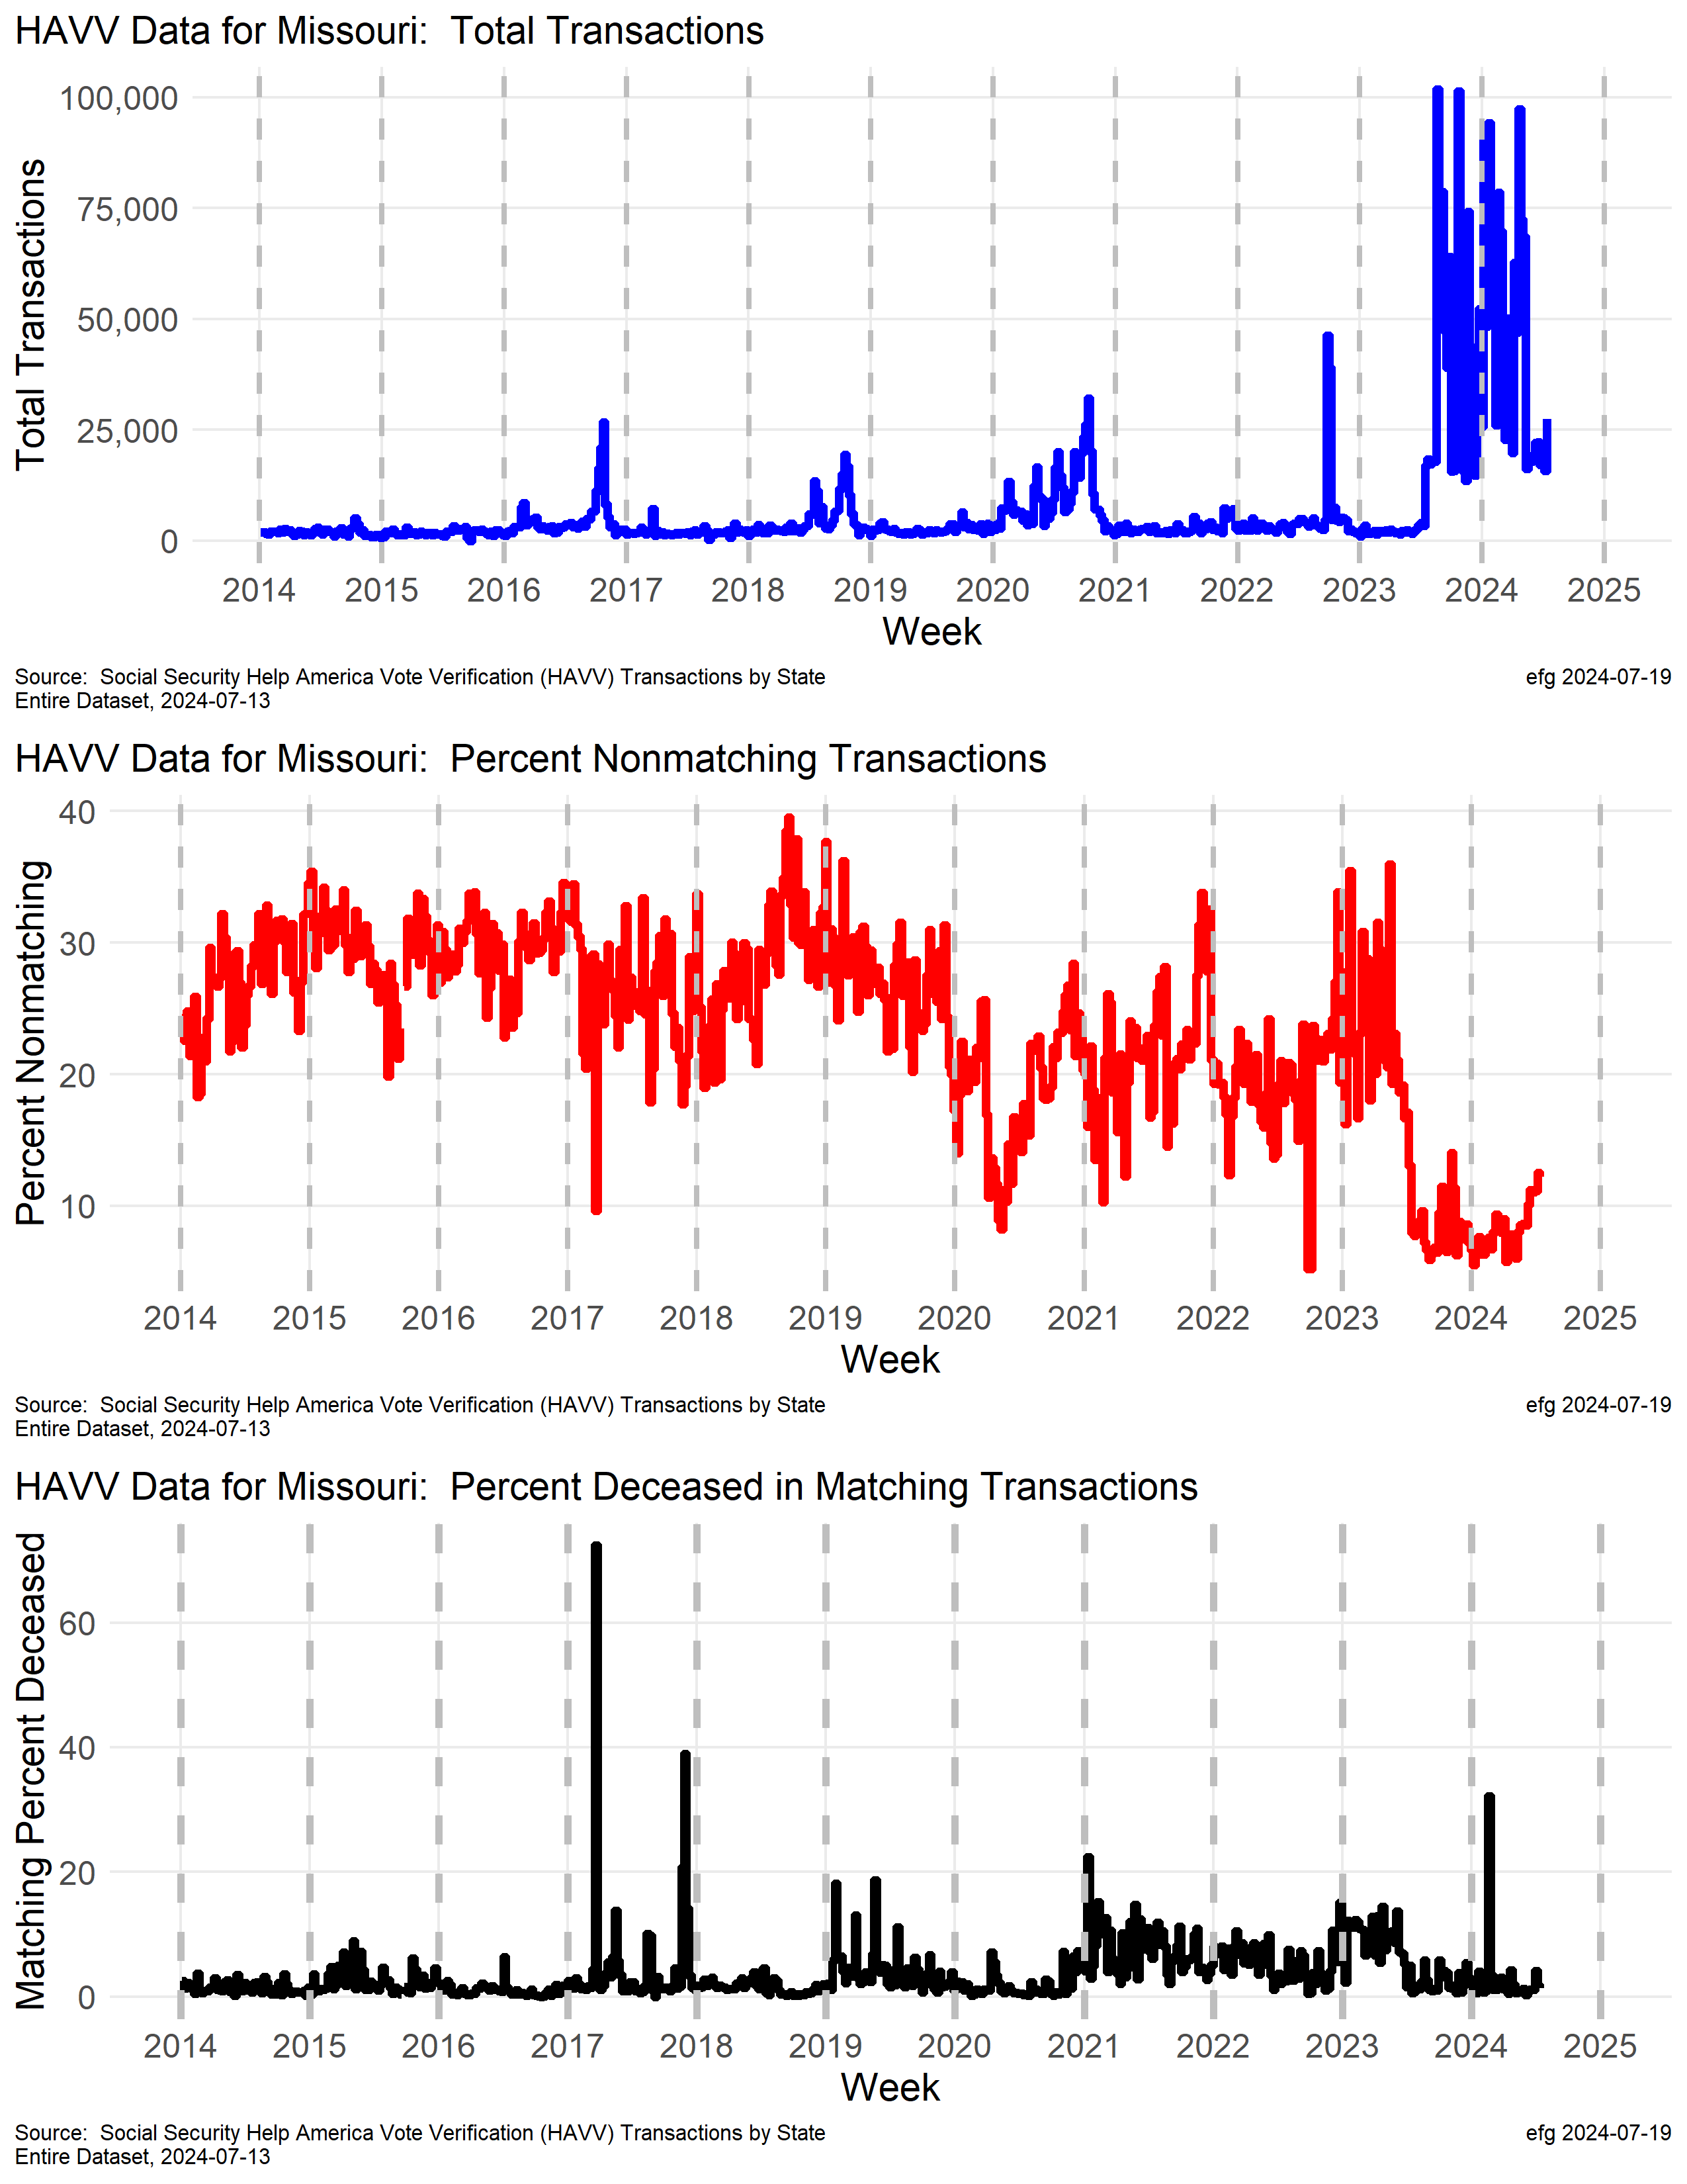
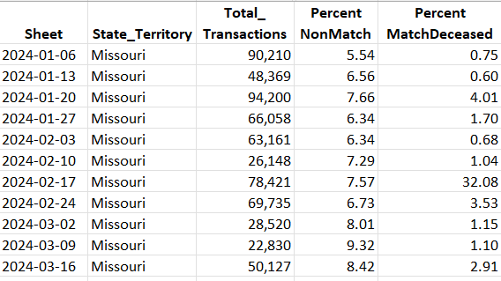
Missouri
Why has the weekly transaction rate increased in late 2023 and 2024 with wide wide week-to-week swings?
Why did the week ending Feb. 17, 2024 have a 32% deceased match rate?
June 20 +72,000

Slide 31
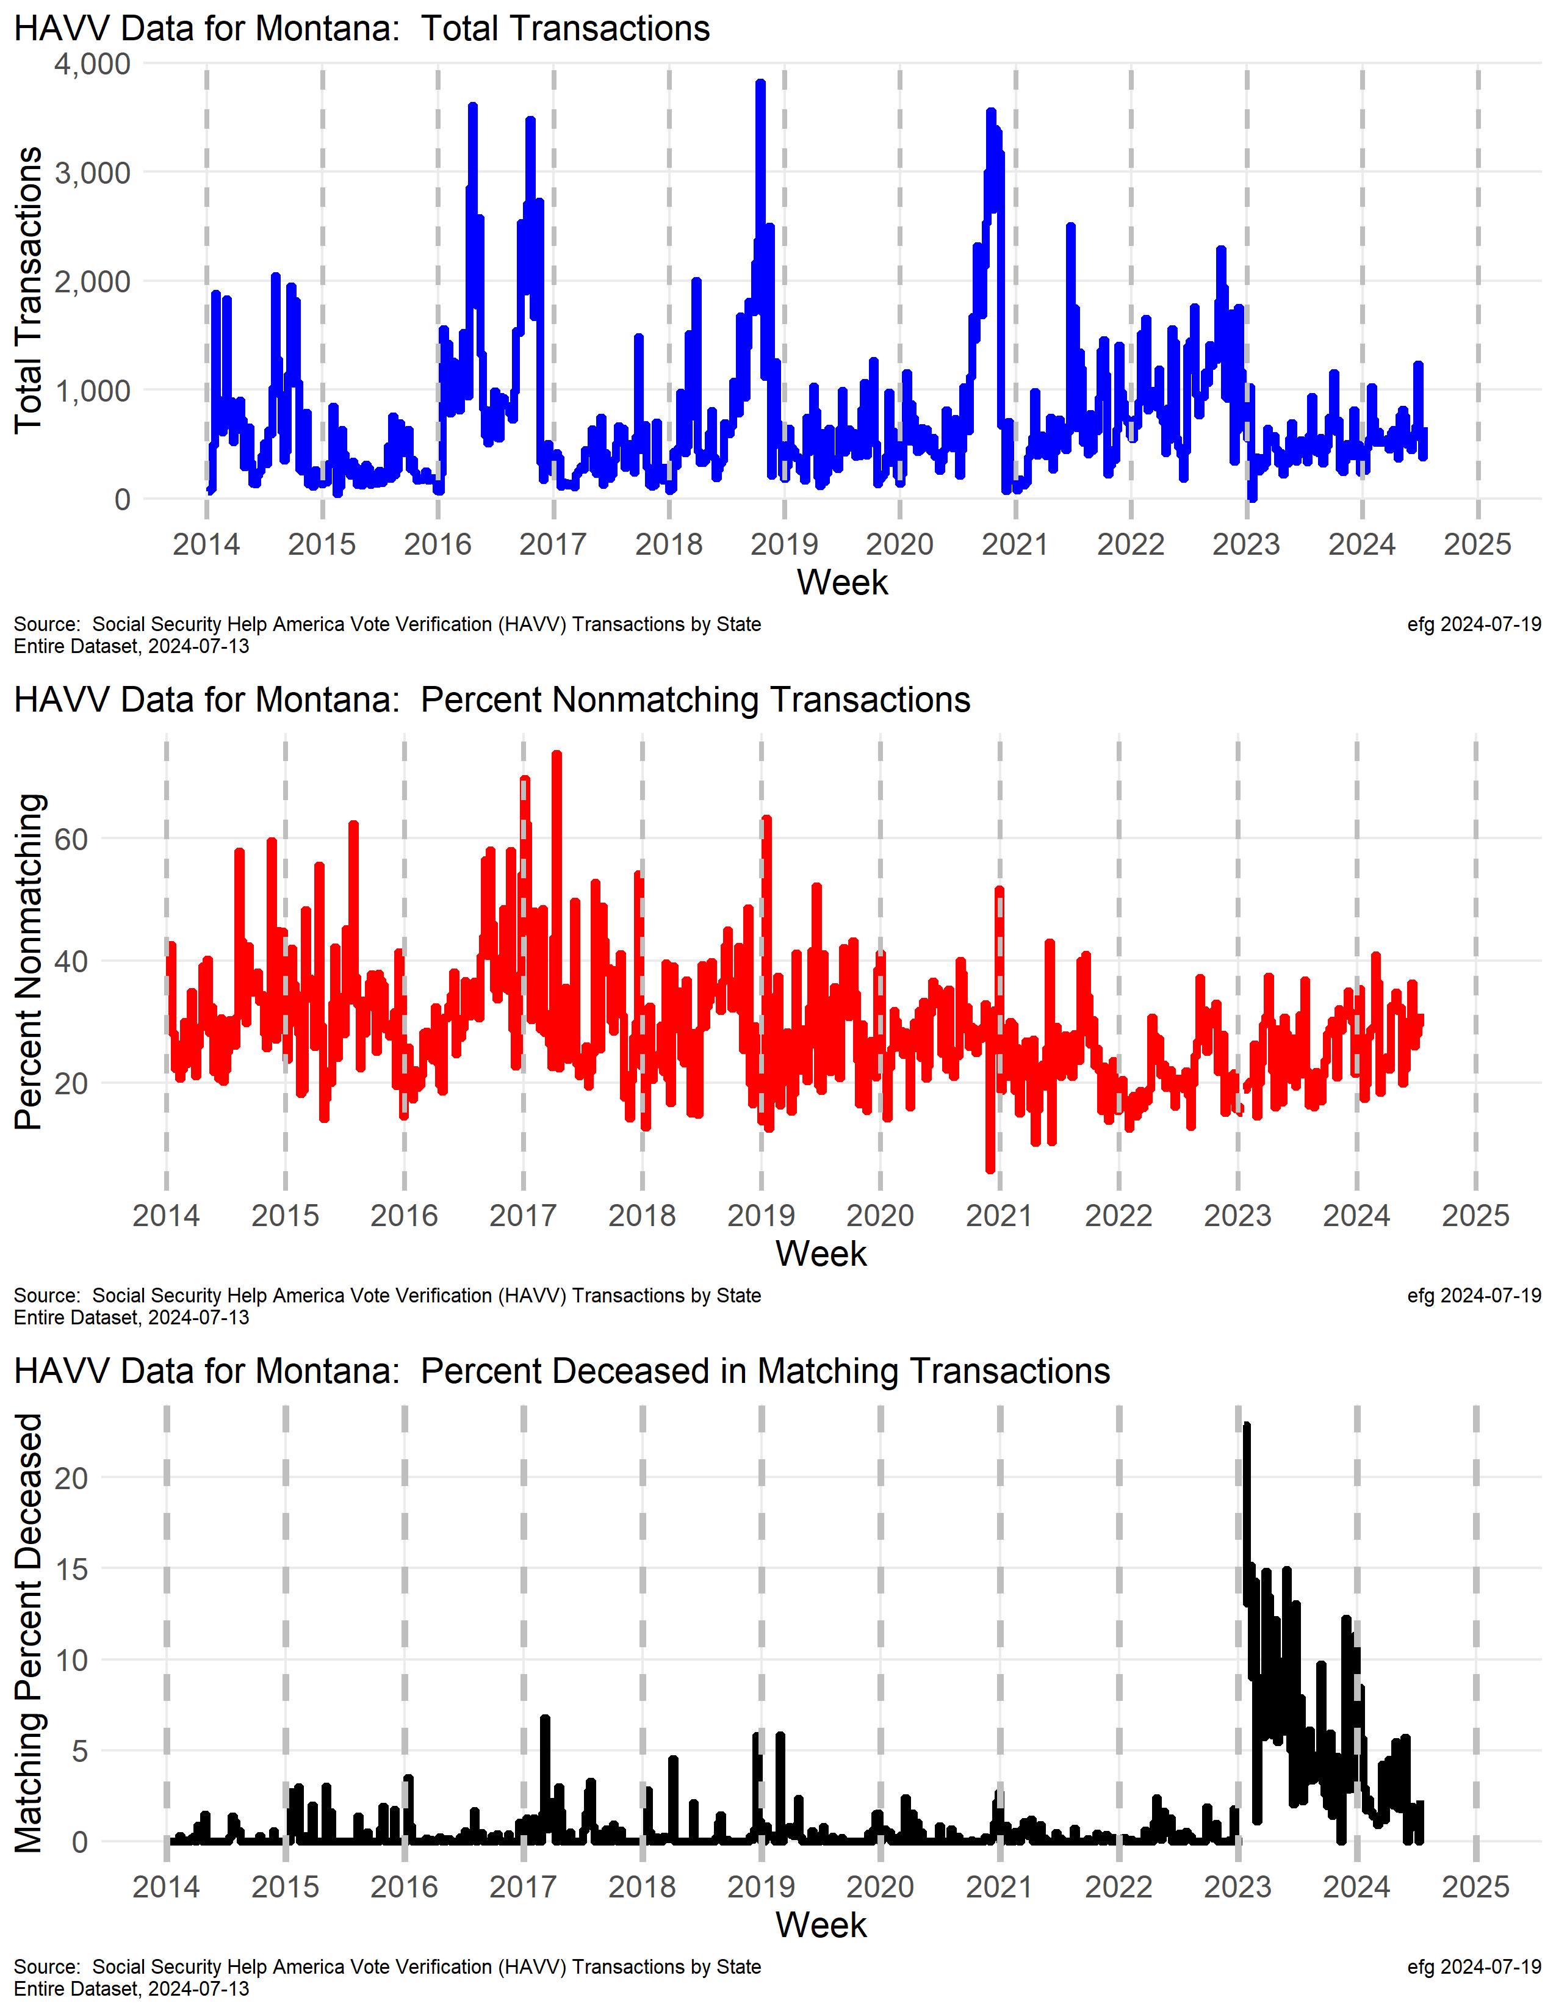
Montana
Why did the deceased match rate greatly increase in early 2023 after being fairly stable from 2014 through 2022?
Why has this rate been declining since the spike in eary 2023?

Slide 32
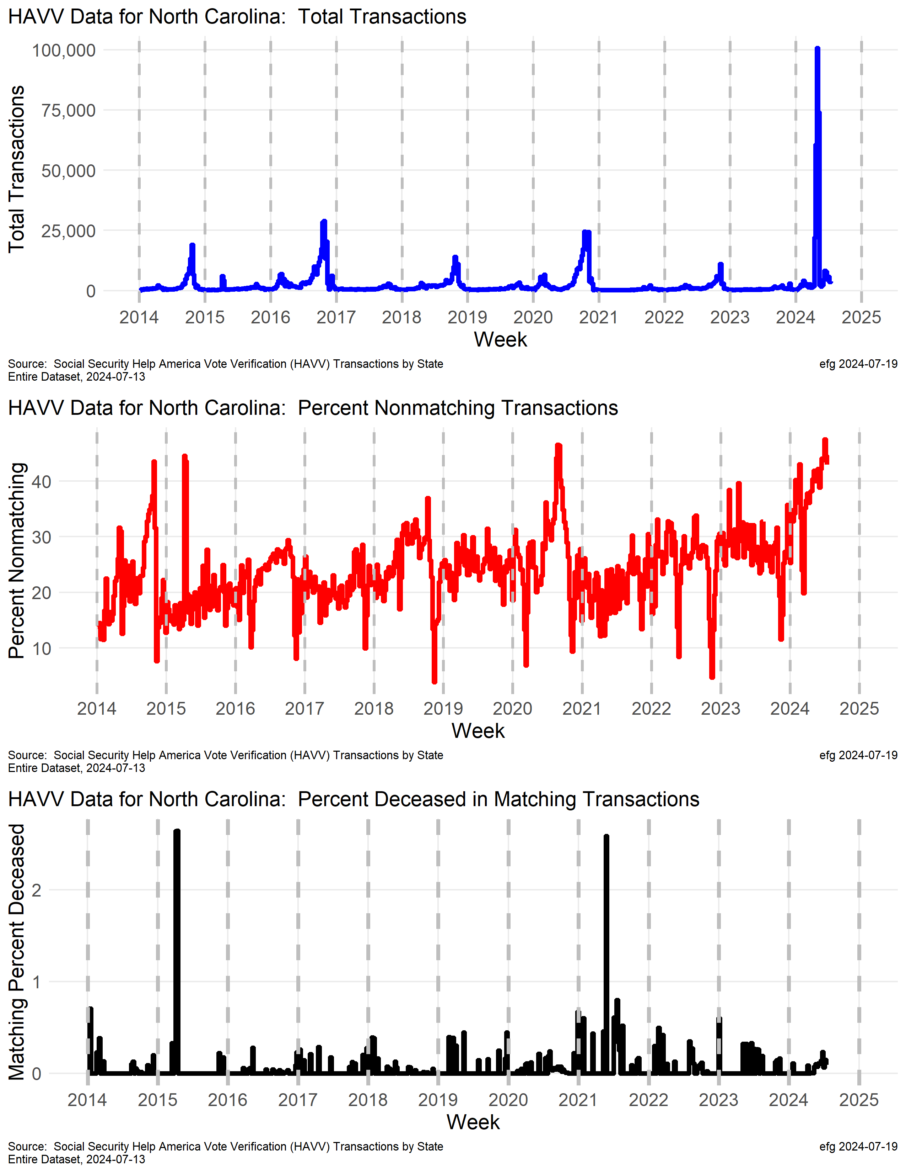
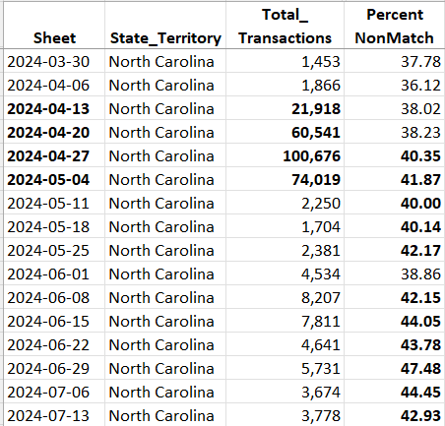
North Carolina
What caused the transaction spike in April – after the presidential primary? Why is the nonmatch rate trending higher since 2021?

Slide 33
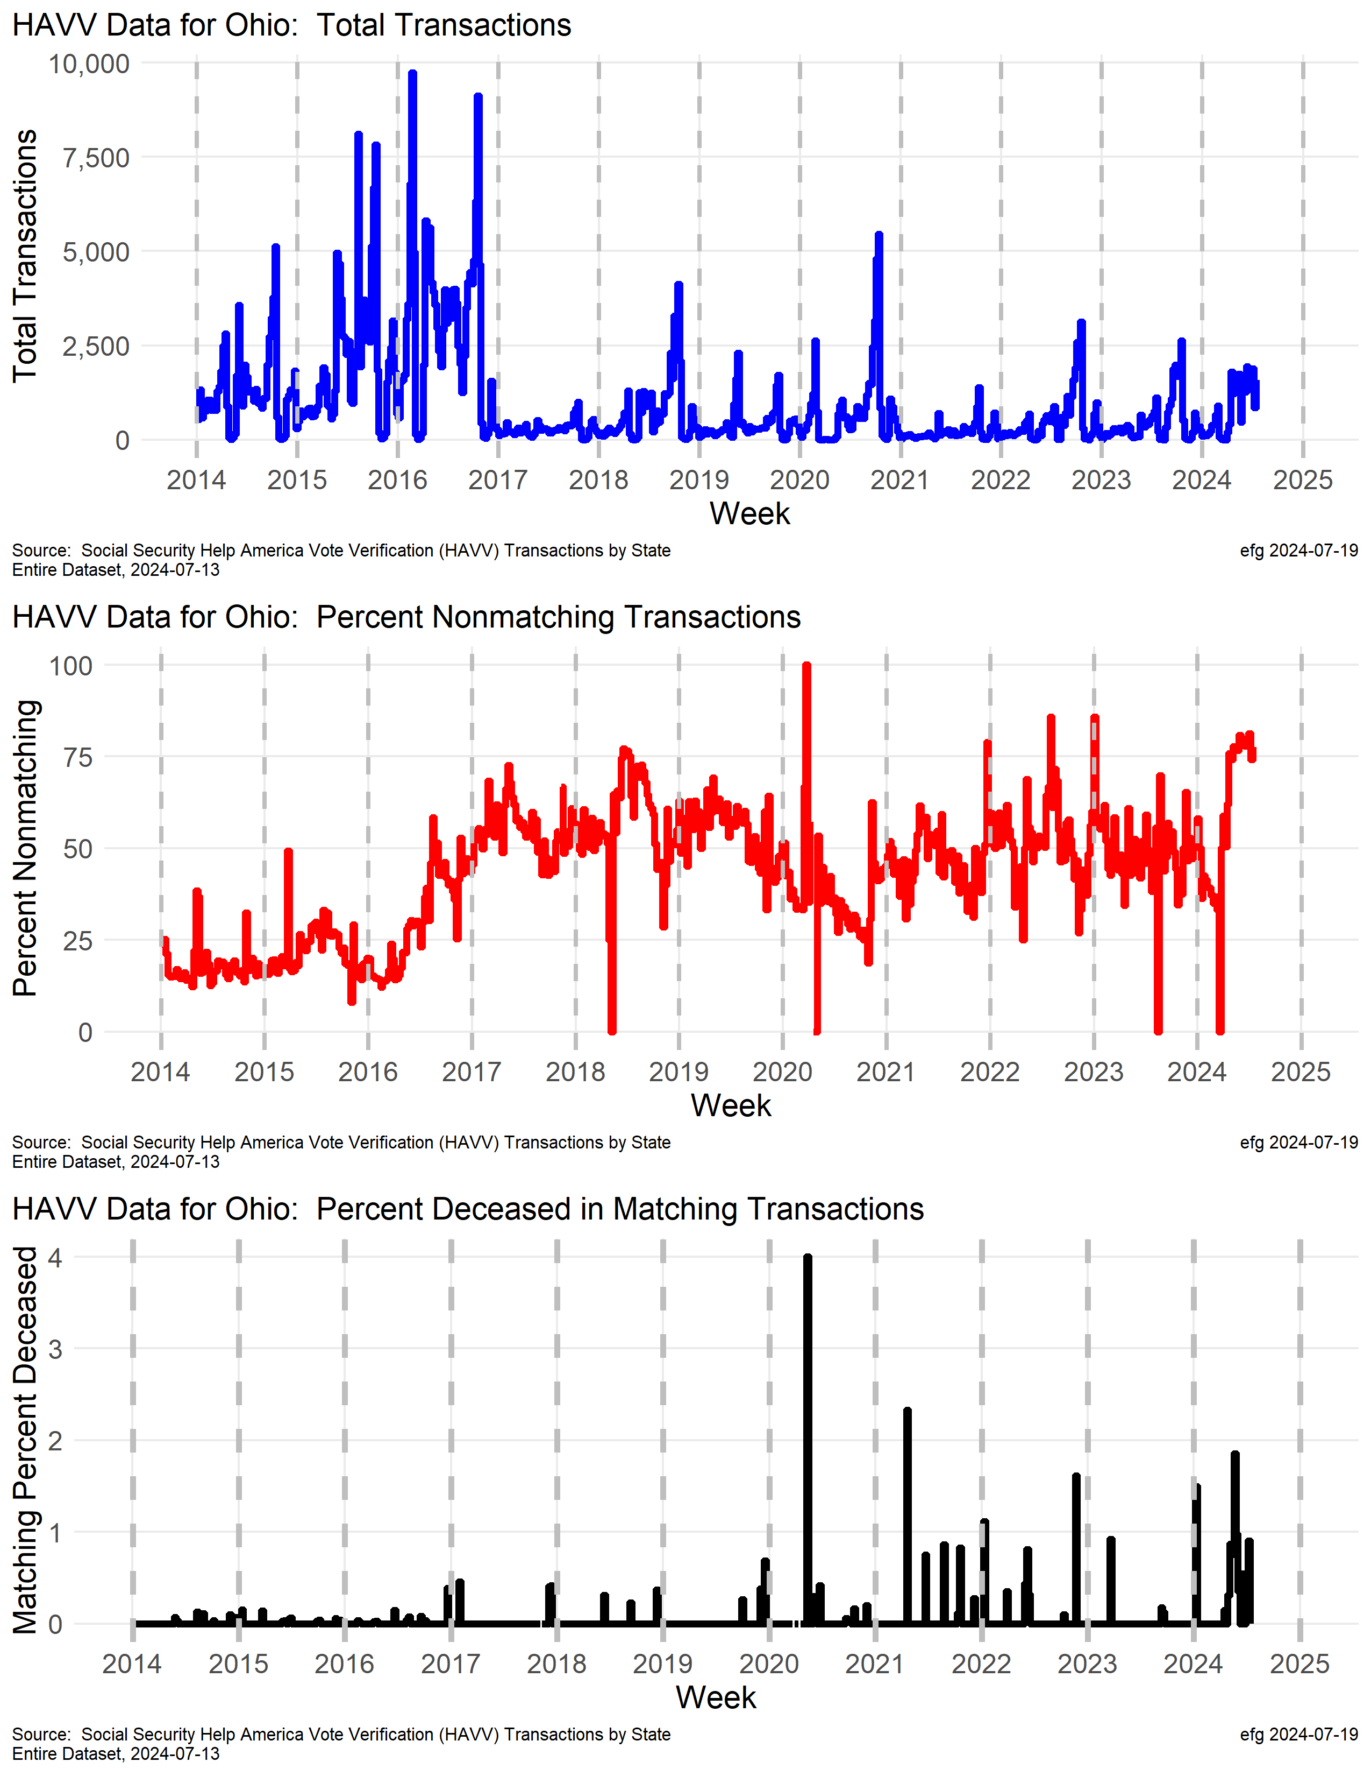
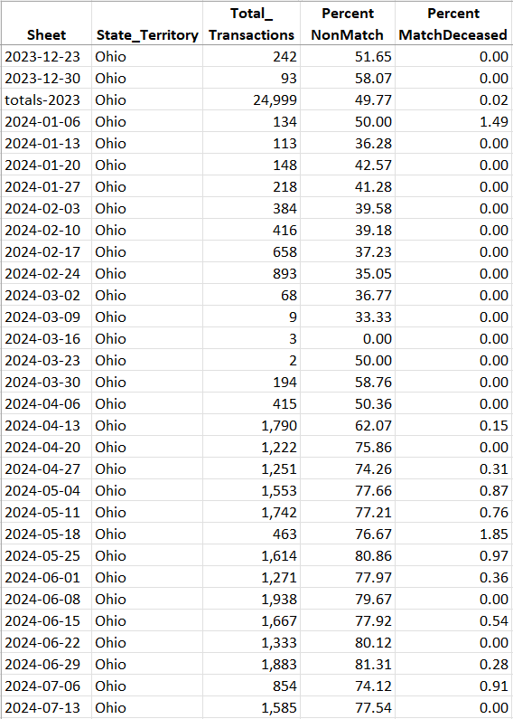
Ohio
Why were weekly transaction rates so variable from 2014 to 2017?
Why does Ohio often have 70+% nonmatch rate in recent months?
1 out 1

Slide 34
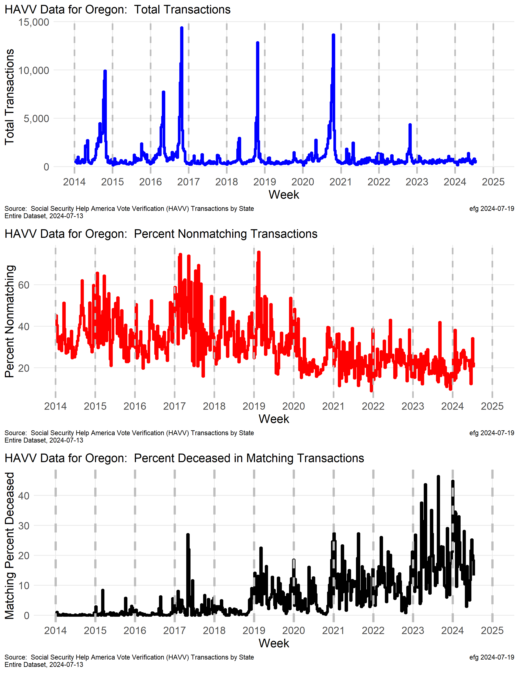
Oregon
Oregon has a periodic spike in transactions before Nov. general elections. Why was the spike in 2022 so small compared to other years?
It's curious that Oregon's nonmatch rate has been trending downward since about 2019, but the match deceased rate has been trending upward during this same period, and sometimes is over 40%.!!
watchdoglab.substack.com/p/ questions-about-help-america-vote

Slide 35
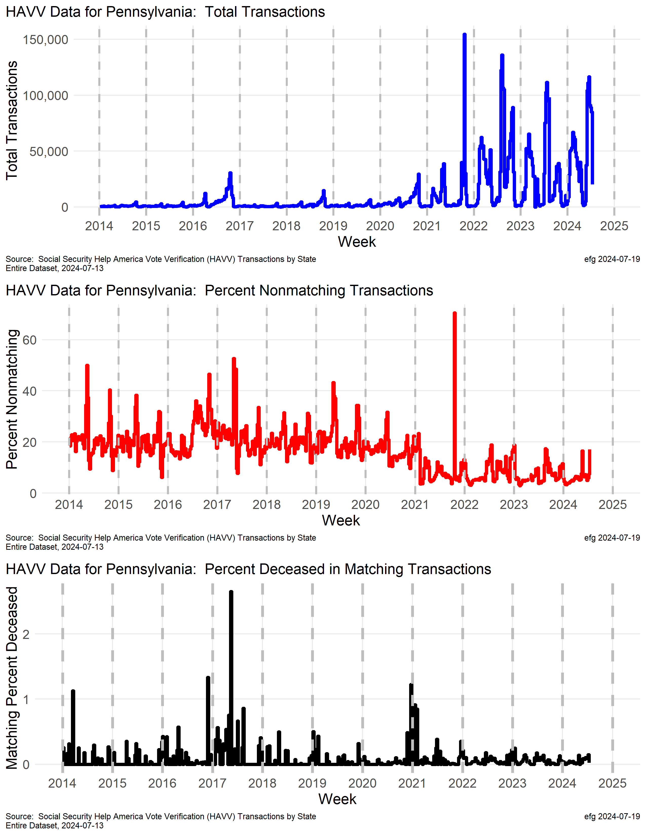
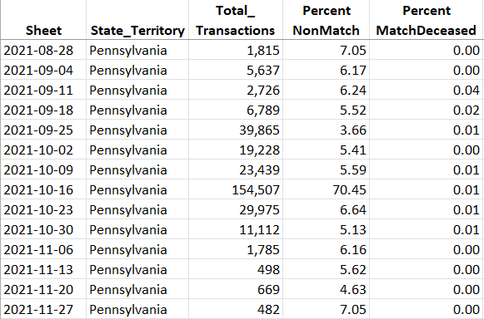
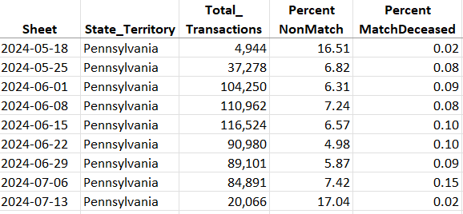
Pennsylvania
While the nonmatch rate has been trending lower since 2017, and the death match rate is very low, what causes the swings in transactions starting in late 2021?

Slide 36
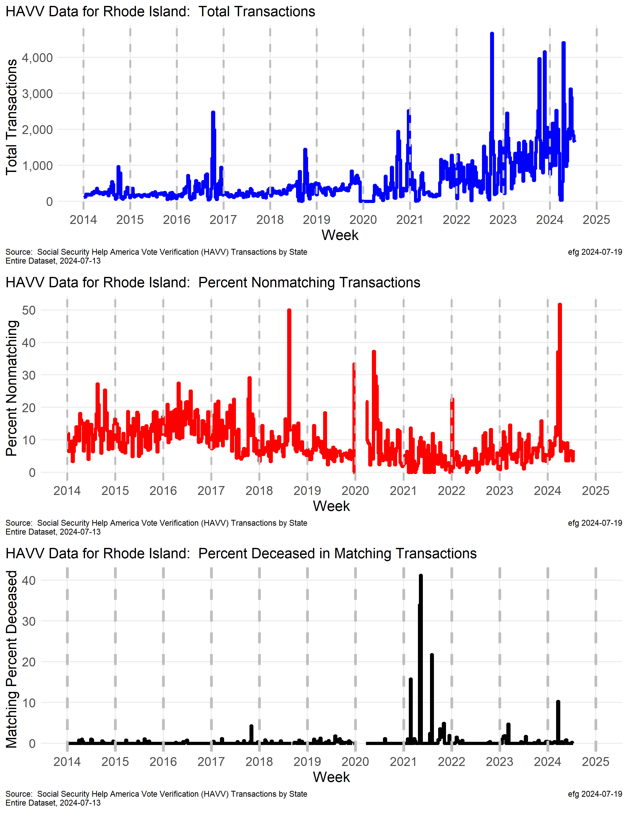
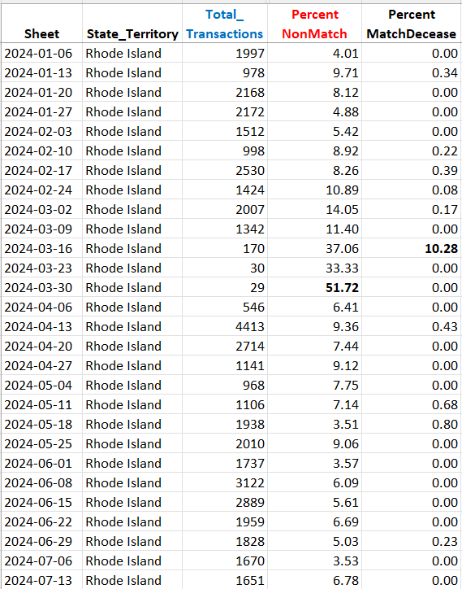
Rhode Island
Problems with small batches should be investigated if we knew “where.”
Small “n”

Slide 37
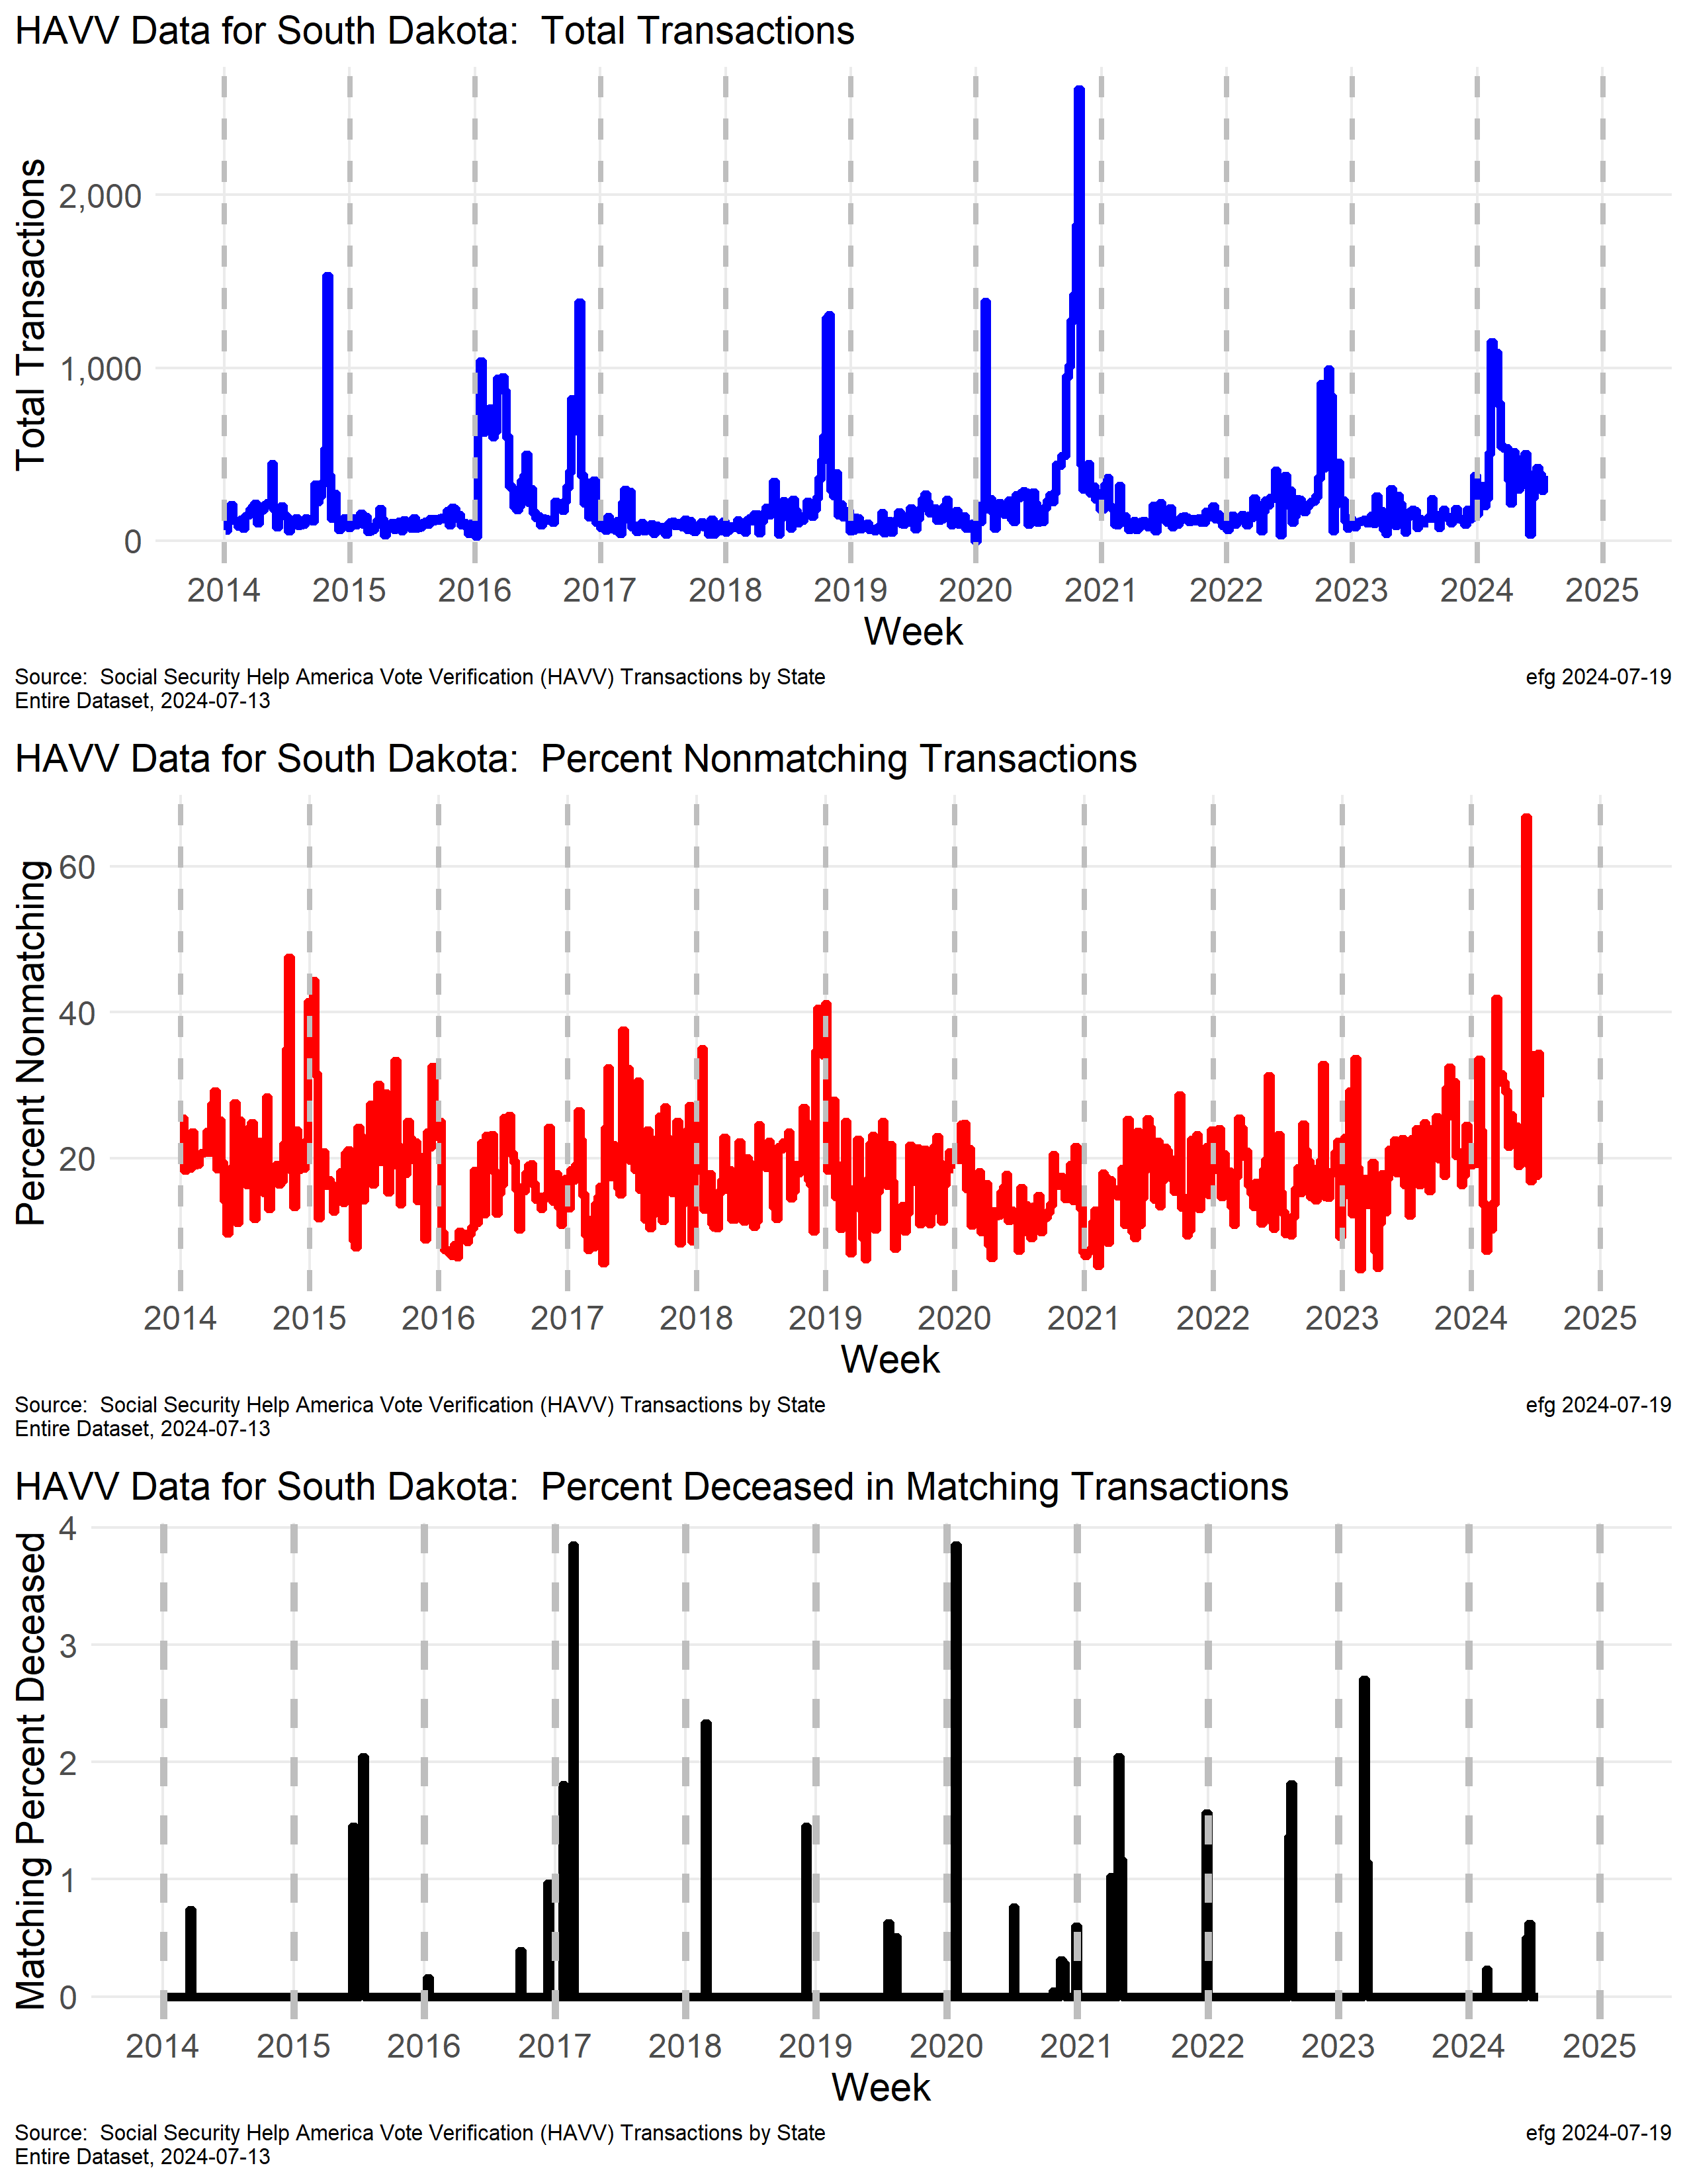

South Dakota
The nonmatching transaction rate hit 67% in the week ending June 1, 2024 when there were only 39 transactions.
Small “n”

Slide 38


Utah
2020 Election
Why is Utah’s nonmatching percentage trending upward to sometimes over 50% since after the 2020 election?
Notes:
Transaction spike in late 2021, early 2022

Slide 39
States with “Consistent” Reporting
Mostly “consistent” but with some irregularities
CT, FL, ID, IN, LA, MN, MS, NJ, WA, WY [10]

Slide 40

Connecticut

Slide 41

Florida

Slide 42

Idaho
Why did the deceased rate decline so much after the 2020 election?

Slide 43

Indiana

Slide 44

Louisiana

Slide 45

Minnesota
Election year peaks in weekly transaction rates.

Slide 46


Mississippi
Some weeks in 2024 with 50+% nonmatch rates or 50+% high deceased match rates.

Slide 47

New Jersey
Election year peak in 2020 election.
Notes:
Chronic issue of over 50% nonmatch rate

Slide 48

Washington
2020 Election year peak in transactions and nonmatch rate.

Slide 49

Wyoming
Curiosity in 2017. Was whole state database processed with a high deceased rate present?

Slide 50
Low Transactions or Minimally Participating
Almost no HAVV data reporting
Huge gaps in years
Small state with low transaction rates
Low transaction rates (small “n”) can result in “spikes” in percentages
DE, DC, HI, ME, NH, OK, VT [7]

Slide 51



Delaware
District of Columbia
Hawaii

Slide 52



Maine
New Hamshire
Oklahoma
HAVV starting in ME in 2024?

Slide 53

Vermont

Slide 54










Online GitHub Resources
https://github.com/EarlGlynn/HAVV-analysis
All 50 states + DC; separate Total
Download or View Excel files online
Download or View PNGs/PDFs online

